Slide 1
Ocean Basins
Chapter 15

Slide 2
The Origin of Oceans
15.1

Slide 3
Primordial Earth
Molten
Heated by impacts, radioactive decay
No atmosphere
No oceans or life
Very few volatiles
Artwork showing the early Earth (credit: Walter Myers/SPL)
Notes:
15.1 The Origin of Oceans
Primordial earth was molten, heated by the impacts of plantesimals, radioactive decay
No atmosphere, so sky was black
No oceans and no life on Earth
Surface had very few volatile substances (evaporates rapidly to escape into the atmosphere) i.e. water, CO₂, gasses
Some trapped within the Earth as it formed, since volatiles were spread throughout the dust cloud that formed the galaxy
Primordial eruptions only added <10% of volatiles to the hydrosphere, atmosphere

Slide 4
Solar Wind
Solar wind stripped inner planets of volatiles
Carried to outer regions of solar system
Gas giants
Comets
Artwork of Earth’s magnetosphere, NASA
Notes:
Newly formed Sun stripped inner planets of their volatiles through a stream of ions and electrons (solar wind)
Volatiles carried to the outer reaches of the solar system
Some trapped by the gas giants
Some taken to outer reaches, then combined with residual dust and gas to form comets
Ice and rock, frozen CO₂, ammonia, simple organic molecules

Slide 5
Bolide
Early solar system
Crowded with debris
Bolide
Bolides
Added .001% to overall mass of planet
Imported 90% of volatiles
Impact cause frozen volatiles to vaporize
Notes:
Early solar system crowded with debris (comets, meteoroids, asteroids) left over from planetary formation
Space debris crashed into a planet is a bolide
Debris crashing into Earth added .001% to overall mass of planet, and imported 90% of the modern reservoir of volatiles
Impact causes frozen volatiles to vaporize

Slide 6
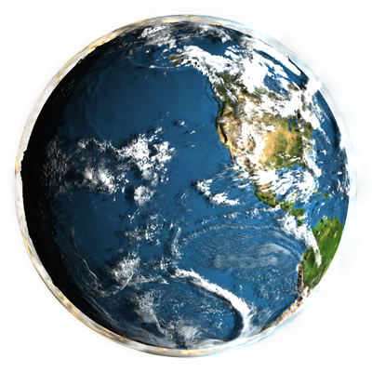
Notes:
As planet cooled, atmospheric pressure increased
Water vapor condensed
Gaseous molecules formed the atmosphere

Slide 7
The Earth’s Oceans
15.2

Slide 8
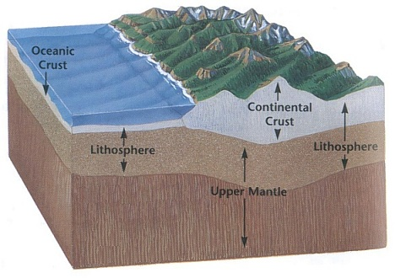
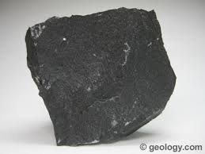
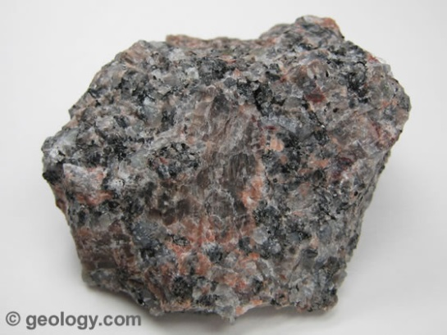
Oceanic Crust vs. Continental
Ocean crust
Dense basalt
4 to 7 km thick
Continental crust
Lower density granite
20 to 40 km thick
Basalt
Granite
Notes:
15.2 The Earth’s Oceans
Ocean rock (basalt) is different than continental rock (granite)
This difference resulted in the accumulation of water in the oceans
Ocean crust is dense basalt, 4 to 7 km thick, while continental crust is lower density granite and 20 to 40 km thick (continental lithosphere is also much thicker)
Thick, continental lithosphere isostatically floats higher, while the dense basaltic lithosphere sinks lower
Water flows downward to collect in the basins
Even with no water, basaltic crust would form basins compared to granitic crust

Slide 9
The Oceans
Cover 71% of surface
Average depth of 5 km
2 to 3 above mid-ocean ridges
11 km in Marianas Trench
1.4 billion km³ of water
Change over geologic time
Global climate and biosphere
Solar energy
Evaporation
currents
Notes:
Oceans cover 71% of surface
Average depth of 5 km (2 to 3 km above mid-ocean ridges, 11 km in Marianas Trench)
Contain 1.4 billion cubic kilometers of water
18 times more than the volume of the land above sea level
If Earth were a smooth sphere, it would have a global ocean 2 km deep
Size and shape of oceans change over geologic time
Right now, Atlantic is widening and Pacific is shrinking
Oceans affect global climate and the biosphere
Absorb and store solar energy
Most evaporation occurs over the oceans
Transport heat and energy through currents from the equator to the poles

Slide 10
Studying the Sea Floor
15.3
Notes:
15.3 Studying the Sea Floor
75 years ago, there were better maps of the Moon than the sea floor
Modern oceanographers use several techniques to map the ocean floor

Slide 11
Samples – Rock Dredge
Steel net dragged along the sea floor
Notes:
Sampling
Several devices collect sediment and rock directly from the sea floor
Rock dredge - open mouth steel net that’s dragged along the sea floor and breaks rocks from submarine outcrops

Slide 12
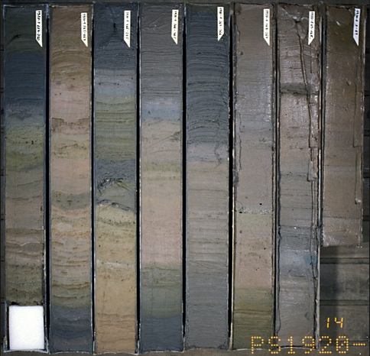
Samples – Sediment Core
Hollow steel tube driven into soft sediment
Joides Resolution
Marine Sediment Cores
Notes:
Sediment core - weighted hollow steel tubes driven into soft sediment and the mud is forced up the pipe - carefully removed cores can preserve the sedimentary layering

Slide 13
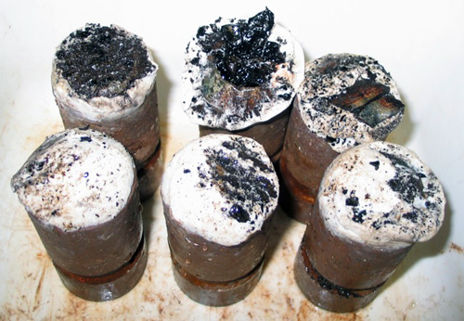
Samples – Wax Cores
Sticky wax picks up shards of volcanic glass
2004 Juan de Fuca expedition
2011 MBARI expedition
Notes:
Wax cores - pipes filled with viscous, very sticky wax are dropped over the side and the wax picks up shards of basaltic glass

Slide 14
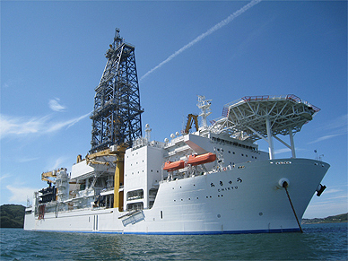
Samples – Sea-floor Drilling
Oil exploration
Core samples of ocean crust
Chikyū
JOIDES Resolution
Notes:
Sea-floor drilling - developed for oil exploration, take core samples from the ocean crust
Drill rigs mounted on off-shore platforms and research vessels
Cylindrical cores
Samples from several kms deep in the ocean crust

Slide 15
Samples – ROV
2004 MBARI expedition to the Juan de Fuca

Slide 16
ROV Tiburon
2004 MBARI expedition to the Juan de Fuca

Slide 17
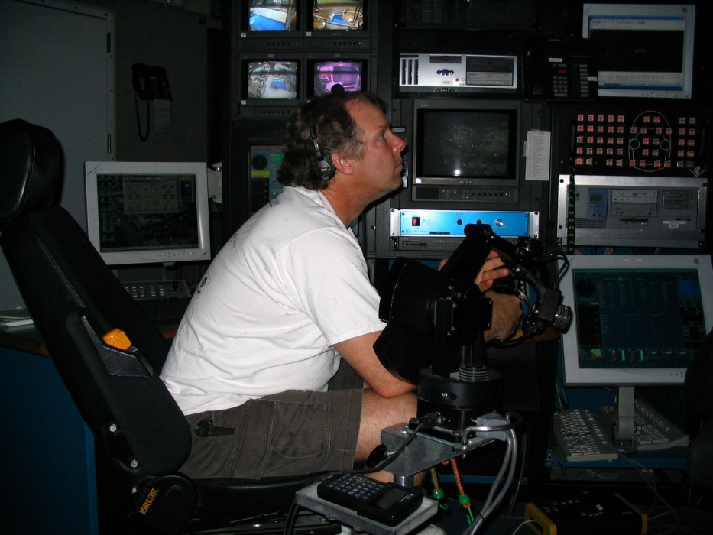
Control Room
2004 MBARI expedition to the Juan de Fuca

Slide 18
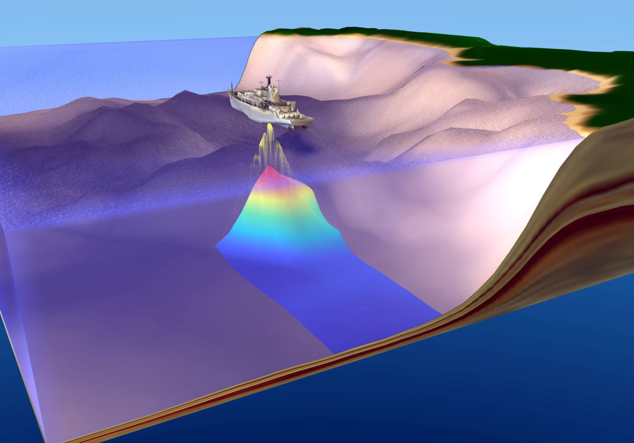
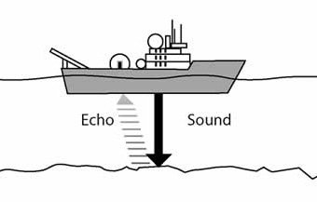
Remote Sensing – Echo Sounding
Map sea floor topography through timing of sound reflections
SONAR
Notes:
Remote Sensing
Don’t require direct contact with the sea floor and can be effective and economical
Echo sounder - used to map sea floor topography
Sound signal originates from a vessel and is then recorded after bouncing off the sea floor and travels back to the ship
Water depth calculated from time it took the sound to travel down and back
SONAR - can transmit 1000 signals at a time

Slide 19
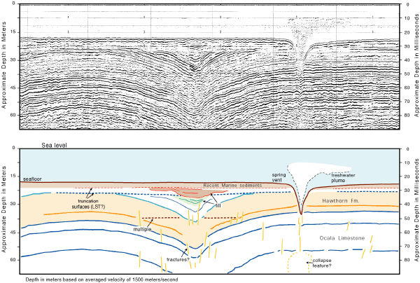
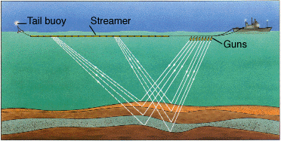
Remote Sensing – Seismic Profiling
High energy signal that penetrates and reflects off layers of sediment and rock
Structure and topography
Seismic profile off east coast of FL
Notes:
Seismic profiler - high energy signal that penetrates and reflects off the layers of sediment and rock giving a picture of layering and structure of the oceanic crust as well as the topography

Slide 20
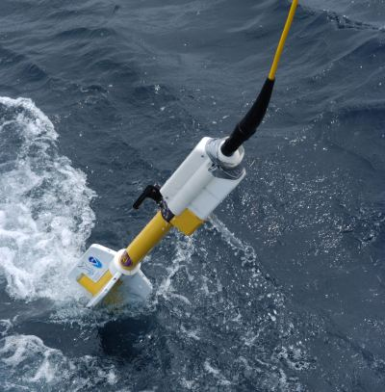
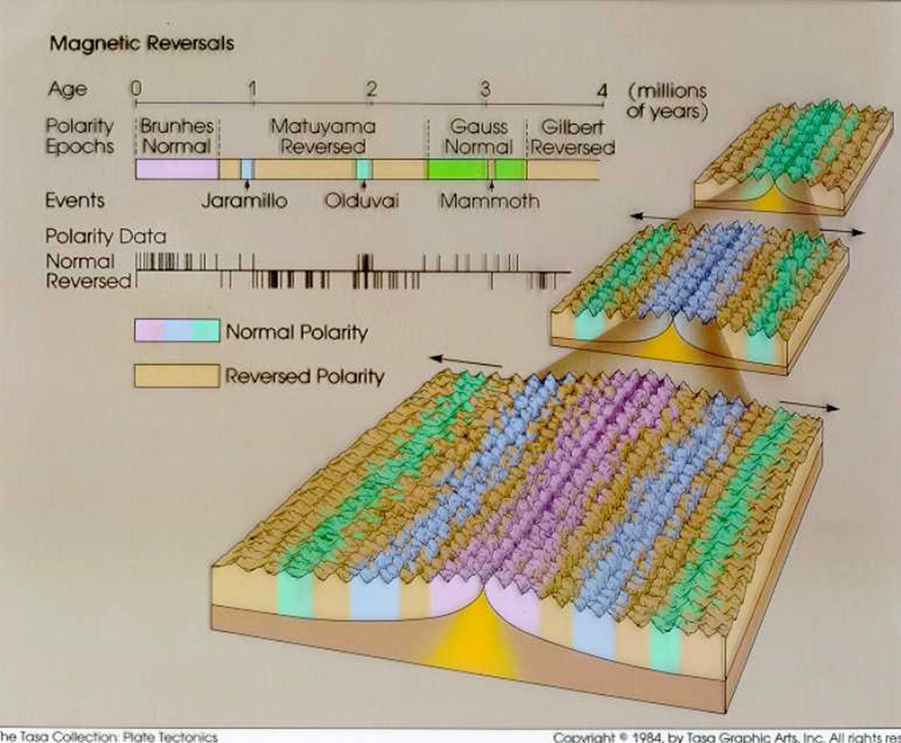
Remote Sensing – Magnetometer
Measures magnetic field
Magnetometer

Slide 21
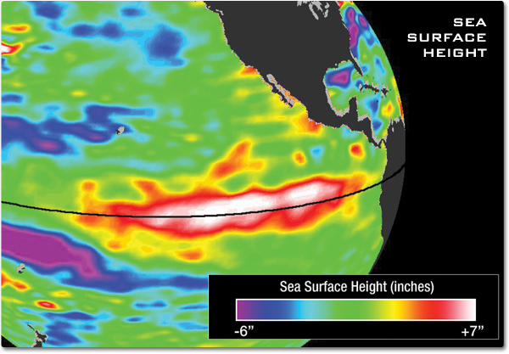
Remote Sensing – Microwave Radar
Microwave pulses from satellites detect swells and depressions on sea surface
Can reflect sea floor topography
Sea surface height during El Nino, NASA
Notes:
Microwave radar - microwave pulses sent from satellites detects swells and depressions on the sea surface that reflect sea floor topography
Mass of a submarine mountain can have enough gravitational attraction to create a swell on the sea surface above it

Slide 22
Features of the Sea Floor
15.4

Slide 23
The Mid-Ocean Ridge System
After WWI, sea floor surveys find Mid-Atlantic Ridge
WWII – submarines
Echo sounding
Sea floor topographic diversity
Notes:
15.4 Features of the Sea Floor
The Mid-Ocean Ridge System
After World War I, sea floor exploration began in earnest and the surveys found the Mid-Atlantic Ridge
WWII, commanders needed accurate maps of the sea floor to support submarine warfare
Early maps made through echo sounders
Sea floor has as much topographic diversity as the continents
Broad plains, mountain peaks, deep valleys

Slide 24
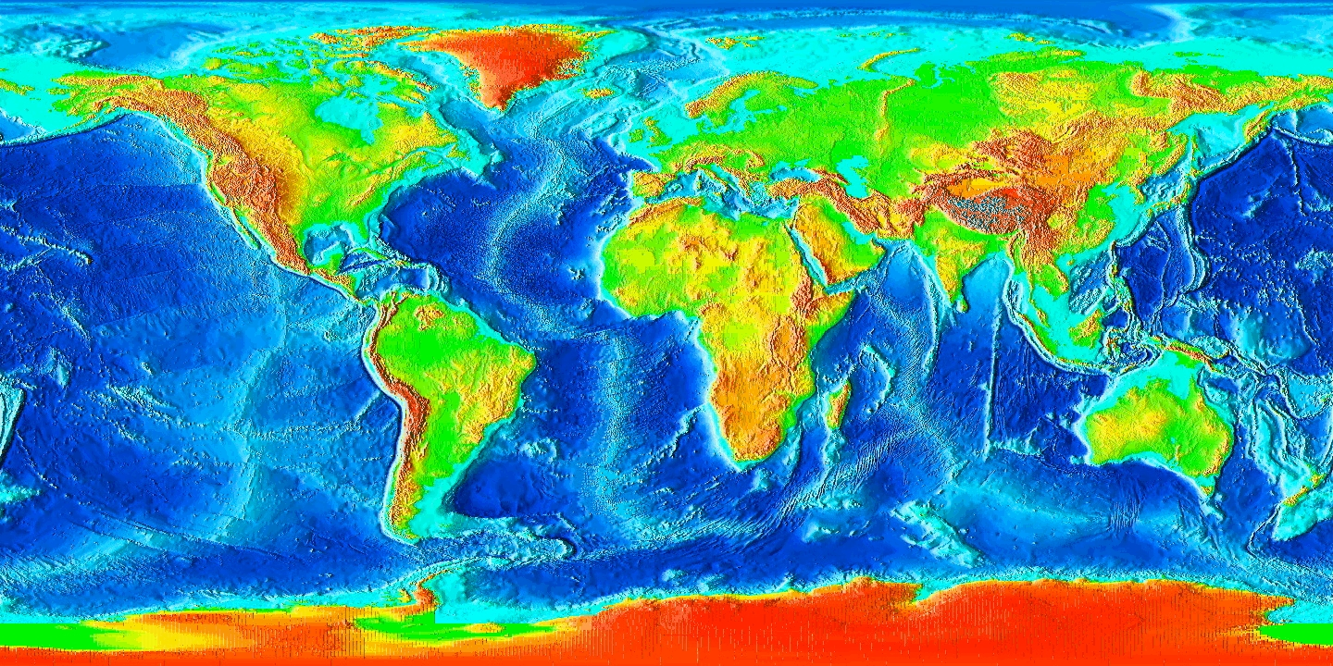
Notes:
Mid-ocean ridge system almost completely submarine (on land in Iceland) and forms a continuous mountain chain
Over 80,000 km in length
More than 1,500 km wide in some places
Rises an average of 2 to 3 km above the surrounding sea floor
Covers more than 20% of the Earth’s surface, about 2/3 of the continents

Slide 25
Rift Valley
Elongate depression at divergent plate boundary
1 to 2 km deep
Several km wide
Volcanic
New crust warmer, less dense
Buoyantly rises
Crust cools as it moves away from ridge axis
Density increases, crust thickens and sinks
Notes:
Rift valley elongate depression that forms at a divergent plate boundary
1 to 2 km deep and several km wide splits segments of the crust
Basaltic magma rises through cracks in the brittle upper parts of the crust to become new crust as the lithosphere separates
New crust is warmer and less dense which causes it to buoyantly rise above the surrounding sea floor
As it moves away from the ridge axis, the crust cools and becomes denser, thicker and sinks
Extensional - normal faults, shallow earthquakes are common

Slide 26
Transform Faulting
Transform faults cut across rift valley and ridge
Extend through entire thickness of lithosphere
Ridge segments offset
Accommodate spherical shape of planet
Small to large offsets
Notes:
Transform faults cut across the rift valley and ridge
Extend entire thickness of the lithosphere
Small segments of the mid-ocean ridge are offset from one another by the transforms to accommodate Earth’s spherical shape
Small to large offsets, some so large they become transform plate boundaries

Slide 27
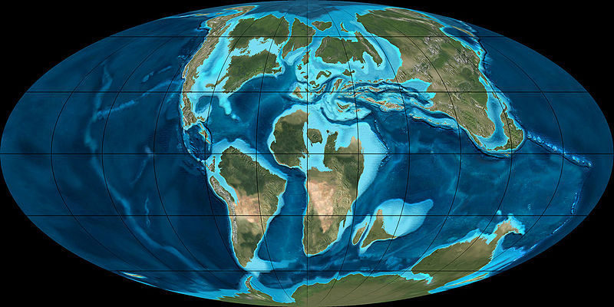
Global Sea Level Changes and the Mid-Ocean Ridge System
Thin layers of marine sedimentary rocks on continents
Late Cretaceous sea level
Notes:
Global Sea Level Changes and the Mid-Ocean Ridge System
Thin layers of marine sedimentary rocks on the continents show that that area was once below sea level and covered by ocean
Tectonic activity lowered the area
Sea level rose globally by hundreds of meters
Glacier growth and receding
Water evaporates from the ocean and is then frozen in continental ice sheets during ice ages, causing sea level to drop
Receding glaciers, the meltwater makes its way back to the oceans and sea level rises
Pleistocene Ice Age cycle of glaciation and interglacials caused sea level to fluctuate as much as 200 meters
Most marine rocks on land don’t correspond to times of glacial melting

Slide 28
Spreading Rates and Ridge Volume
Mid-ocean ridge sit buoyantly higher
Hotter, less dense
Displaces water
Highest in center, where crust is hottest
Elevation decreases as crust thickens and cools
Fast vs. slow spreading rates determine amount of water displaced
Notes:
The mid-ocean ridge sits buoyantly higher since it’s hot and less dense and it displaces a large amount of water
If the modern mid-ocean ridge disappeared completely, sea level would fall by ~400 meters
Smaller ridge, less water displaced
Larger ridge, more water displaced
Highest in center, where crust is hottest, elevation decreases on both sides as crust thickens and cools
Slow spreading rates allow the crust to cool before it gets too far from the ridge axis
Narrow ridge, displace low volume of water
Fast spreading center, hot crust extends further out before cooling
Wide ridge, displaces large volume of water
Rate of sea-floor spreading has varied throughout geologic time and unusually fast during the late Cretaceous which would have created a large, high-volume ridge profile, displaced more water, which would have flooded the low-lying portions of continents

Slide 29
Life on the Mid-Ocean Ridge System
Rarely significant light beyond 200 m depth
No sunlight for photosynthesis
Huge, unique ecosystems found on the sea floor
Notes:
Life on the Mid-Ocean Ridge System
Sunlight can penetrate to about 1000 meters, but rarely any significant light beyond 200 meters (656 ft.) while the average depth of the ocean floor is 5 km
No sunlight to support photosynthesis but there are huge, unique ecosystems found in isolated parts of the sea floor

Slide 30
Chemosynthesis
Ocean water flowing through fractures in basaltic crust
Hot water dissolves metal and sulfur and rises back to sea floor
Black smokers
Metal precipitates out when hot water comes in contact with cold sea water
400°C and toxic
Chemosynthetic bacteria
Foundation of deep sea food chain
Notes:
Hot rocks heat seawater that flows through fractures in the oceanic crust, that hot water dissolves metals and sulfur in the rock, and then rises back to the sea floor surface
Black smoker - the metals in the hot water precipitate out as the hot water comes in contact with the cold ocean water
Up to 400° C and toxic to most organisms
These vents support life through bacteria that produce energy through chemosynthesis
Foundation of deep sea food chain and larger vent organisms feed off of them or use them symbiotically
Tube worms host the bacteria and feed of their waste
Giant clams, mussels, eyeless shrimp, crabs, fish

Slide 31
2004 MBARI Juan de Fuca expedition
Example of what high pressure at ocean floor does to styrofoam.

Slide 32
2004 MBARI Juan de Fuca expedition
ROV dive pictures
~2300 meters depth
~1.4 miles

Slide 33
2004 MBARI Juan de Fuca expedition
ROV dive pictures
~2300 meters depth
~1.4 miles

Slide 34
2004 MBARI Juan de Fuca expedition
ROV dive pictures
~2300 meters depth
~1.4 miles
Sponges

Slide 35
2004 MBARI Juan de Fuca expedition
ROV dive pictures
~2300 meters depth
~1.4 miles
Crab

Slide 36
2004 MBARI Juan de Fuca expedition
ROV dive pictures
~2300 meters depth
~1.4 miles
Ratfish

Slide 37
2004 MBARI Juan de Fuca expedition
ROV dive pictures
~2300 meters depth
~1.4 miles
Octopus

Slide 38
2004 MBARI Juan de Fuca expedition
ROV dive pictures
~2300 meters depth
~1.4 miles
Dumbo / Octopod

Slide 39
Ocean Trenches and Island Arcs
Convergent zone
Older, colder, denser plate sinks subducts
Oceanic trench
Magma generated
Submarine volcanoes
Island arc
Notes:
Ocean Trenches and Island Arcs
Convergence between two oceanic plates, the older, colder, denser plate subducts under the other forming a subduction zone
Sinking plate drags the other plate downward forming an oceanic trench
Marianas Trench, southwest Pacific - 11 km below sea level
Depths of 8 to 10 km common in other trenches
Magma generated in the subduction zone
Erupts and forms submarine volcanoes next to trench
Volcanoes grow to become islands - volcanic island arc
Numerous convergent plate boundaries in Pacific

Slide 40
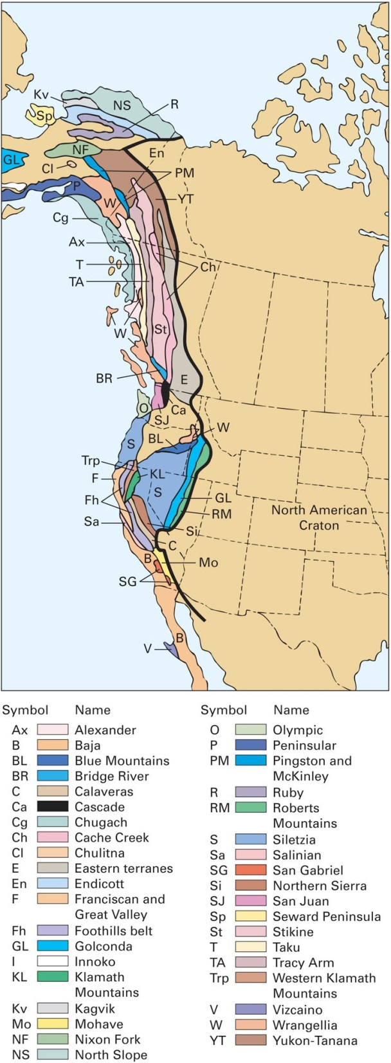
Island Arcs – Accreted Terranes
Island arc rides plate
Not dense enough to be subducted
Accreted onto continental crust
Notes:
If subduction stops, then volcanism stops and the island arc “rides” on the plate until it runs into another convergent boundary
Island arc is younger, hotter, less dense (andesitic) rock - too buoyant to sink into the mantle
Island arc collides with the continent
Subducting plate fractures on the seaward side to create a new subduction zone
The island arc breaks away from ocean plate and joins the continent that it collided with
Western California, Oregon, Washington, western British Colombia are pieces of island arcs that collided with North America from 180 to 50 million years ago
Accreted terranes

Slide 41
Seamounts, Oceanic Islands, and Atolls
Seamount
Submarine volcano that rises at least 1 km above ocean floor
Oceanic island
Hot spot volcanoes that rise above sea level
Single peaks
Chains
Hawaii
Once volcanism stops, rocks cool, become more dense and island sinks
Becomes seamount
Notes:
Seamounts, Oceanic Islands, and Atolls
Seamount - submarine volcano that rises at least 1 km above the sea floor
Oceanic island - seamount that rises above sea level
Basaltic
Both common in all oceanic basins, abundant in southwestern Pacific
Can occur as isolated peaks, but commonly occur in chains
Hot spot volcanoes on the interior of tectonic plates
Single peaks - short lived mantle plumes
Chains - long-lasting plume
Seamount grew as the island was over the plume, then became extinct as the plate moved the volcano away from the hot spot
Islands/seamounts get older, the further they are from the main hot spot volcanism

Slide 42
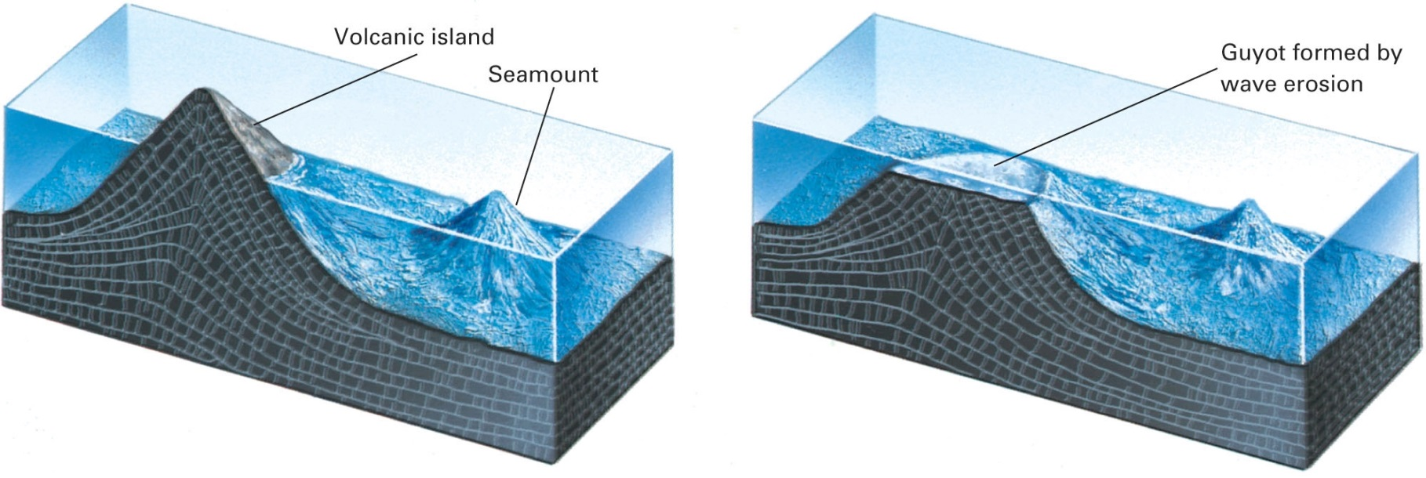
Notes:
After islands form, they begin to sink and eventually turn into seamounts
Magma production stops or island moves away from plume and the rock cools, contracts, and density increases
Weight of volcanic causes the oceanic crust to isostatically sink
Erosion of top of volcano
As it sinks, waves may erode the top, making it flat
Guyot

Slide 43
Atoll
Circular coral reef around a lagoon
Three stages of atoll formation.
Volcanic island with fringing reef. Moorea
Volcanic island with barrier reef. Bora Bora
True coral atoll.
Arno
Notes:
Atolls - circular coral reef around a central lagoon
1 to 130 km in diameter, surrounded by deep ocean
Corals only survive in shallow water, so the initial reef must have formed on the flanks of a volcanic island
As the island sank, the coral reef continued to grow upward, keeping the live coral in shallow water

Slide 44
Sediment and Rocks of the Sea Floor
15.5

Slide 45
Ocean Floor Layers
Oldest oceanic crust 200 million years old
Ocean crust continually subducted and recycled
Seismic profiles and ocean drilling show three layers
Sediment
Pillow basalts
Vertical dikes of basalt overlying gabbro
Notes:
15.5 Sediment and Rocks of the Sea Floor
If oceans are billions of years old, why isn’t the mud on the bottom super thick?
Oldest oceanic crust is only 200 million years old, since ocean crust is continually subducted and recycled
No time for more than a relatively thin layer of mud and sediment to form
Seismic profiling and oceanic drilling show the oceanic crust is made of three layers
1. Sediment
2. Pillow basalts
3. Vertical dikes of basalt overlying gabbro

Slide 46
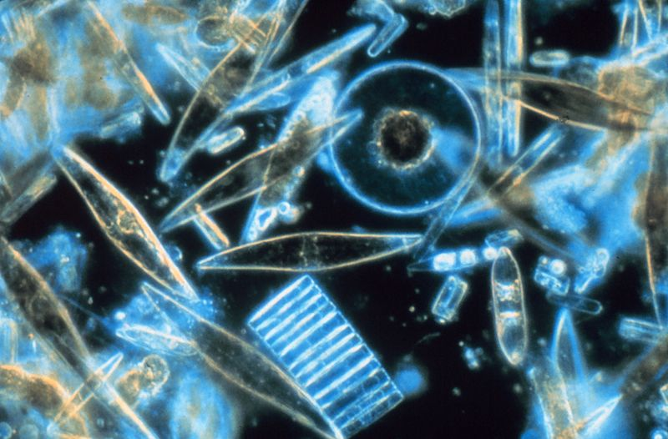
Ocean-Floor Sediment
Layer 1 contains two types of sediment
Terrigenous
Eroded from continents
Pelagic
Mixture of clay carried by wind currents and remains of microscopic ocean creatures
Diatoms, radiolarians, foramnifera, etc.
Accumulates 2 to 10 mm every 1,000 years
Mississippi River delta
Diatoms
Notes:
Ocean-Floor Sediment
Layer 1 is the uppermost layer of oceanic crust
Consists of two types of sediment
Terrigenous sediment - and, silt, clay eroded from continents and carried to deep sea floor by gravity and submarine currents
Found close to continents
Pelagic sediment - grey and red-brown mixture of clay carried from continents by wind currents and the remains of tiny plants and animals that live in the surface waters of the oceans
Plants and animals die, then their skeletons settle to ocean floor
Siliceous ooze, calcareous ooze, red clay
Accumulates 2 to 10 mm every 1000 years

Slide 47
From ridge axis to abyssal plain
No sediment on ridge axis
Newly formed crust
Pelagic sediment thickness increases as you move away from axis
Near shore, pelagic mixes with terrigenous
Abyssal plain
Rugged basaltic topography covered with thick layer of sediment

Slide 48
Basaltic Oceanic Crust
Foundation of all oceanic crust
Formed at ridge axis and spreads outward
Layer 2 – pillow basalts
About 1 to 2 km thick
Layer 3 – basalt dikes overlying gabbro
About 3 to 5 km thick
Pillow basalts on the Juan de Fuca, 2004
Notes:
Basaltic Oceanic Crust
Foundation of all oceanic crust, formed at ridge and spreads outward
Can be altered by ocean water
Layer 2 is below layer 1
About 1 to 2 km thick
Mostly pillow basalt - hot lava coming into contact with cold ocean water forms pillow shaped spheroids
Outside “freezes” into glass while hot magma continues to fill it up like a balloon
Layer 3 is below layer 2
About 3 to 5 km thick
Deepest and thickest layer of the ocean crust
Upper part is vertical dikes of basalt
Magma oozing upward froze in cracks of the rift valley
Lower part is gabbro - coarse-grained, plutonic equivalent of basalt
Dikes above act as insulation and allow the gabbro to cool slowly

Slide 49
Continental Margins
15.6

Slide 50
Notes:
15.6 Continental Margins
Continental margin - where continental crust meets oceanic crust
Passive margin - the continental crust and ocean crust are firmly joined, it’s not a plate boundary, not tectonically active
Continental margins on the Atlantic
Active margin - occurs at a tectonic plate boundary
Convergent boundaries where oceanic crust gets subducted under continental crust
Andean margin on west coast of South America

Slide 51
Passive Continental Margins
Continental crust fractures, thins as rift forms
Ocean spills into rift
Basaltic magma creates new oceanic crust
All tectonic activity is focused at spreading ridge
Notes:
Passive Continental Margins
As Pangea split up, just over 200 million years ago, continental crust fractured and thinned as rifting began between North America and Europe, basaltic magma erupted creating new oceanic crust which eventually widened into the Atlantic Ocean
All tectonic activity is focused at the spreading center at the Mid-Atlantic Ridge

Slide 52
The Continental Shelf
Streams flowing off of continents deposit sediment
Continental shelf
Shallow, gently sloping surface
Sediment laden
Isostatically sinks
Carbonate platforms
Warm, shallow sea with little sediment
Notes:
The Continental Shelf
Stream and rivers flowing from continents deposit their sediment on deltas
The sediment gets eroded and redistributed by ocean currents along the coast, forming a shallow, gently sloping (~.1°) submarine surface called the continental shelf
Goes from sea level to about 200 m depth
Edge of continental crust isostatically sinks slightly due to the weight of the sediment, keeping it below sea level
On passive margins the shelf can grow large
East coast of North America
South eastern Canada - 500 m wide
In warm regions with little sediment (so no rivers), due to the shallow water, coral reefs can grow

Slide 53
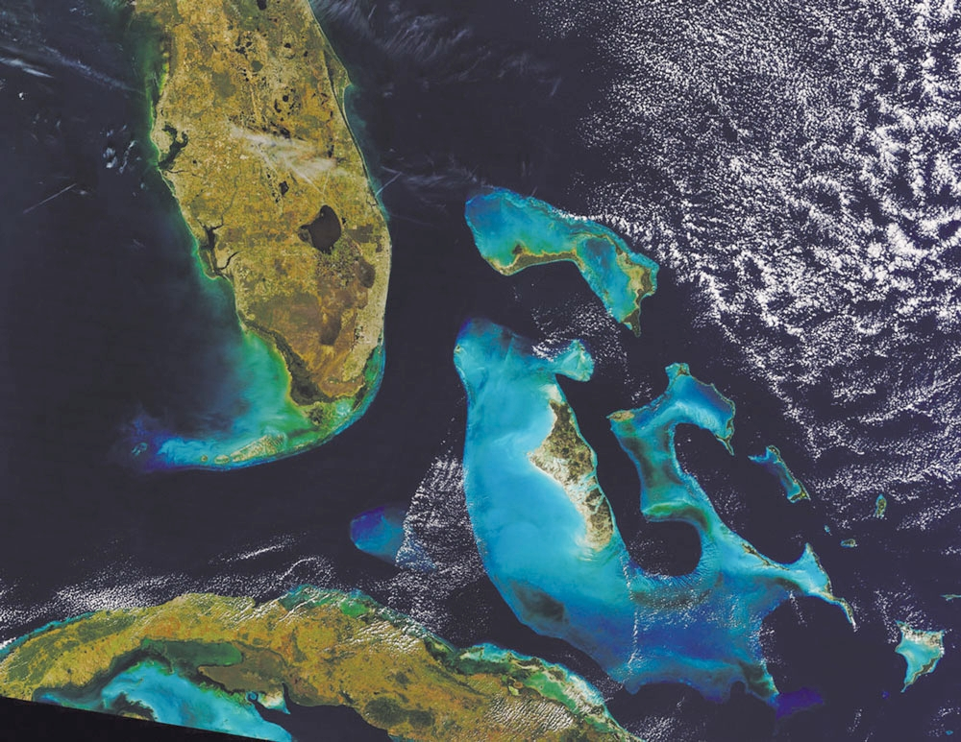
Notes:
Thick limestone beds called carbonate platforms
Florida Keys and Bahamas

Slide 54
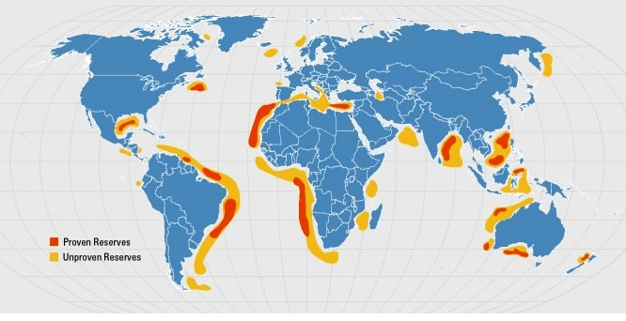
Offshore petroleum reserves
Notes:
Petroleum reserves on the off-shore continental shelves
Deep drill cores show granitic crust under the layers of sediment

Slide 55
The Continental Slope and Rise
Continental slope
Beyond shelf where slope steepens as continental crust meet oceanic
Sediment layer slump due to steepness
Continental rise
Slope levels out and meets deep ocean floor
Apron of terrigenous sediment

Slide 56
Submarine Canyons and Abyssal Fans
Submarine canyon
Deep valley eroded into shelf and slope
Commonly start at river mouth
Turbidity currents
Abyssal fan
Fan shaped deposit of sediment at mouth of canyon
nature.com
Notes:
Submarine Canyons and Abyssal Fans
Deep valleys eroded into continental shelf and slope are submarine canyons
Resemble submarine stream valleys
Starts on outer edge of shelf, through slope, to start of rise
Commonly ends in an abyssal fan
fan shaped pile of sediment lying on the rise
Canyons tend to occur where large rivers enter the sea
Caused by turbidity currents
Erode the shelf and slope and deepen the canyons
Loose, wet sediment tumbling downslope
Caused by earthquakes or sediment piling up above its angle of repose
When the sediment starts to move it mixes with water. Which increases its density and it tumbles downslope in a chaotic avalanche
Lots of energy, lots of erosion
Currents tumble down came channel over and over
Form at river mouths just due to the great amount of sediment coming from the channel
Abyssal fans form at end of canyons formed by turbidity currents, as the current slows and the sediment is deposited
Form only on passive margins (trenches on active margins swallow the sediment)
Most large rivers drain toward passive margins
Bengal Fan off the mouth of the Ganges in India
Covers 4 million km²

Slide 57
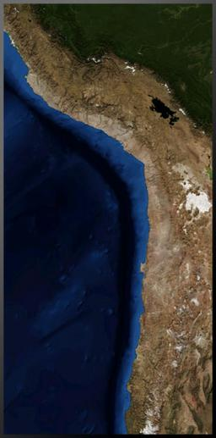
Active Continental Margins
Peru-Chile Trench from space, NASA
Form at convergent margins
Subduction zones
Oceanic trenches
Thick continental crust meets thin oceanic crust
Narrow to no shelf
Landward wall of trench is slope
No rise

