Slide 1
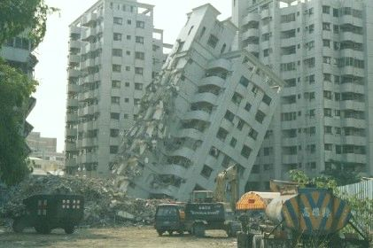
Earthquakes and Earth’s Structure
Chapter 7
Taiwan, 1999

Slide 2
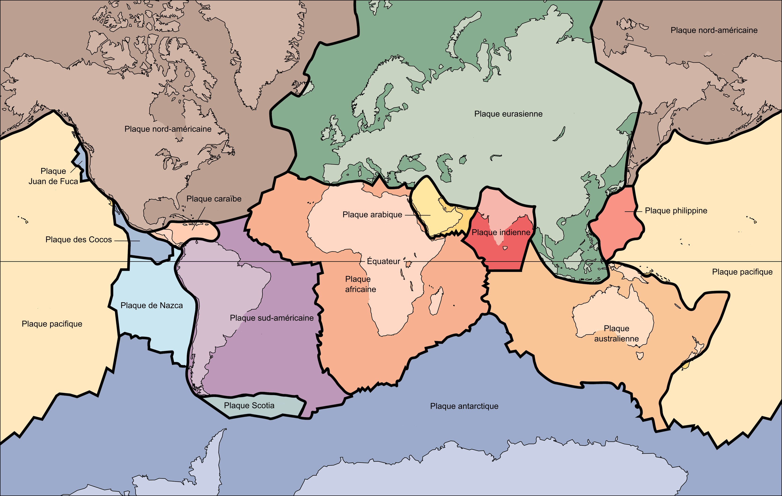
Notes:
Lithospheric plates move slowly over the Earth at rates of < cm to 16 cm per year
At plate boundaries friction can hold the plates locked and stationary – rocks stretch, compress and forces build until the plates finally snap free and the Earth shakes
Earthquake is a threshold effect – plates held by friction, pressure builds until threshold is reached, then a sudden, catastrophic motion occurs
Movement of plates responsible for
Forming oceans and atmosphere via gases released during volcanic eruptions, which brought water to the surface
Creating the continents
Rejuvenating soils
Regulating global chemistry
Concentrating metals

Slide 3
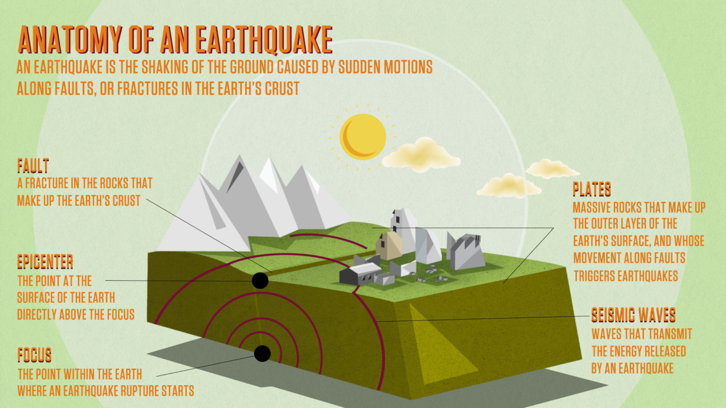
Anatomy of an Earthquake
7.1
infographiclist.com
Notes:
Rocks appear rigid but when enough stress is applied, rocks will deform
Elastically
Fracturing
Plastically

Slide 4
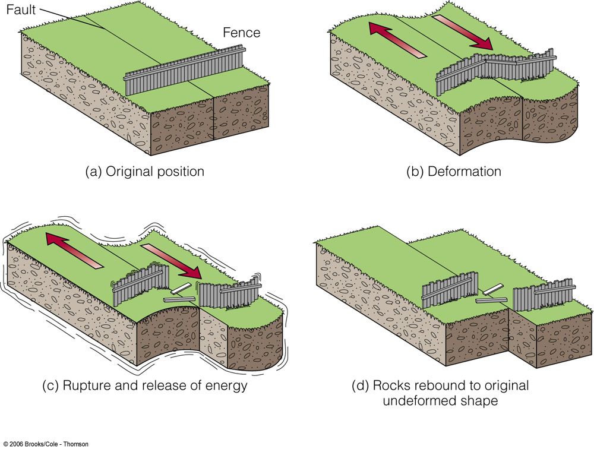

Elastically
Small amounts of stress – returns to original shape when stress is removed
Notes:
Elastically – small amounts of stress, returns to original shape when stress is removed
Rubber band – energy is stored in the stretched rubber until it’s released and the rubber band returns to its normal shape

Slide 5
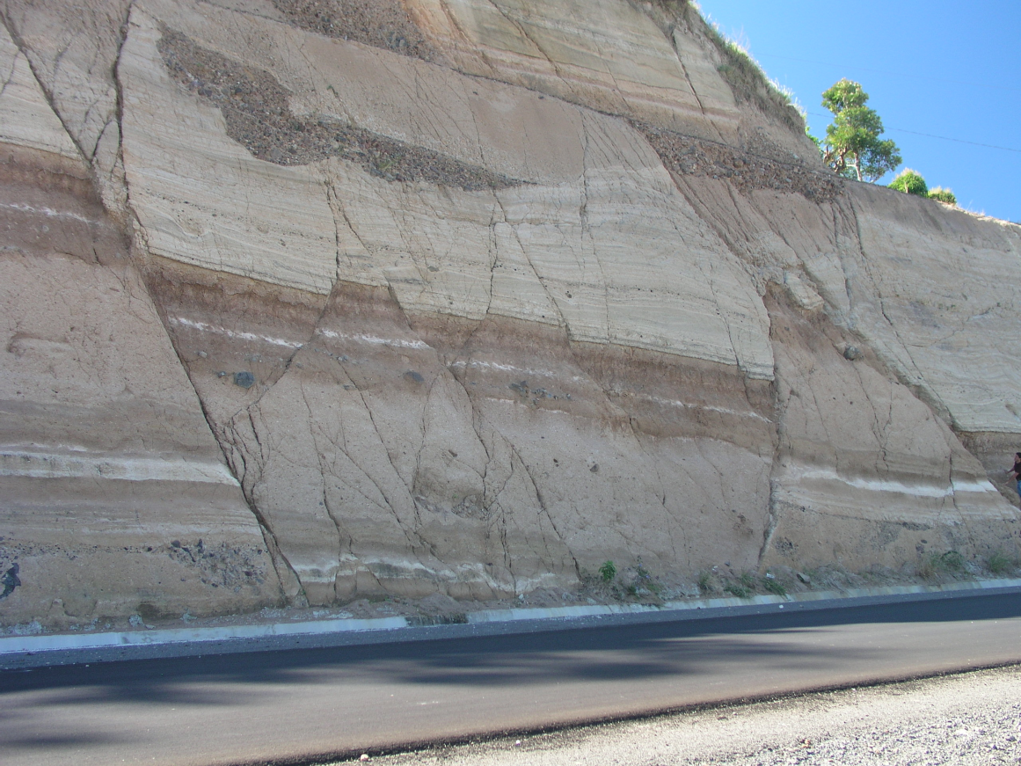
Fracturing
Rocks have a limit, beyond which they cannot deform elastically, then, under certain conditions, it fractures
Normal faults in
volcanic ashes and
paleo-soils,
El Salvador,
photo by
Chuck DeMets
Notes:
Rocks have a limit beyond which it cannot deform elastically – then, under certain conditions, it fractures – when large masses of rock deform and then fracture, it creates the vibrations of an earthquake

Slide 6
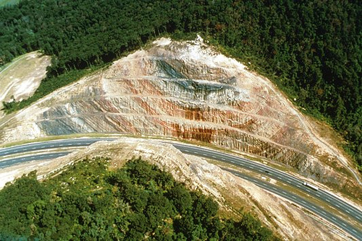
Plastically
Plastic deformation occurs when the rock keeps its new shape when stress is relieved
Steven Biars
Notes:
Other conditions will allow it to deform plastically – plastic deformation – it keeps its new shape when stress is relieved – energy wasn’t stored, so no energy to suddenly released (no earthquake)
Sideling Hill, Maryland (Syncline)

Slide 7
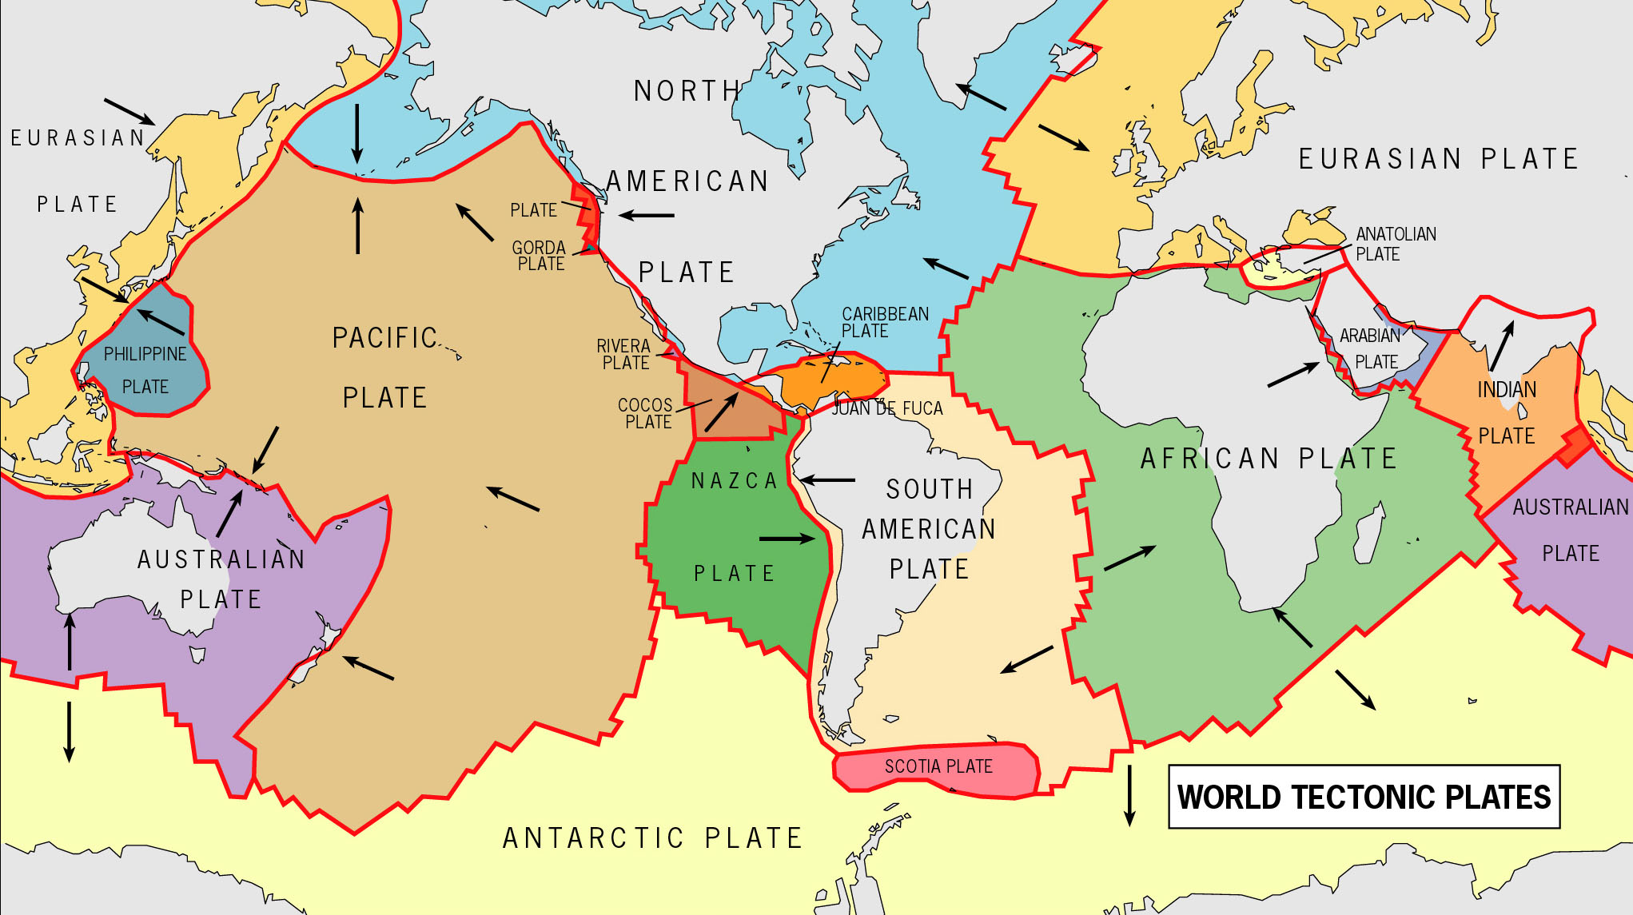
Notes:
Seven large (and many smaller) tectonic plates that move at different rates
Friction prevents the plates from moving past one another continuously
Cool, strong rock near the boundary stretches or compresses elastically, while pressure builds until a critical level (threshold) is reached and the rock snaps loose or fractures (the energy is suddenly released) causing the ground to rise and fall or undulate in an earthquake

Slide 8
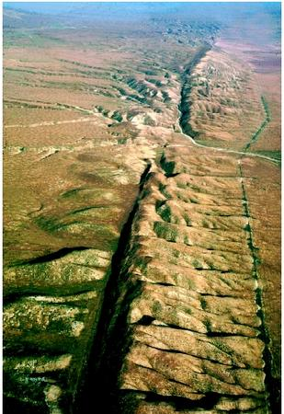
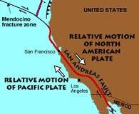
San Andreas Fault
Notes:
Most movement occurs along established faults (San Andreas)
Weaker than the surrounding, solid rock
Occasionally solid rock can fracture creating a new fault
Movement is only cm to a meter – single earthquake makes only small changes in the geography – over geologic time, it changes the surface of the planet

Slide 9
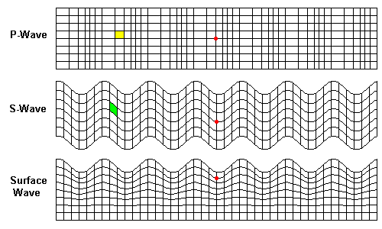
Earthquake Waves
7.2
Notes:
Book example: Tapping a watermelon to test for ripeness
Sharp, clean knock = ripe, dull thud = mushy
Energy of tap travels through the melon
Nature of interior affects the quality of the sound

Slide 10
Waves
Wave transmits energy from one place to another
  Waves through rock are seismic waves
  Earthquakes and explosions create seismic waves
  Seismology – study of earthquakes and nature of earth’s interior based on seismic waves

Slide 11
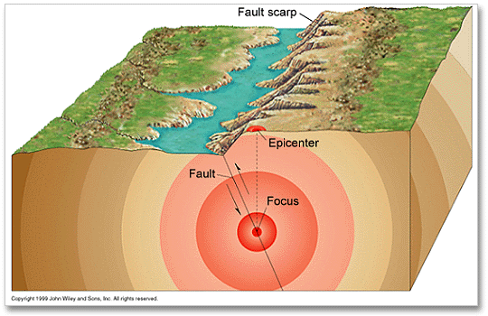
fOCUS and Epicenter
Notes:
Focus – initial rupture point, where the energy was released and abrupt movement occurred – usually below the surface
Epicenter – point on surface directly above the focus
Two types of seismic waves
Body waves – travel through the interior and carry some energy from the focus to the surface
Surface waves – radiate from the epicenter and travel along the surface

Slide 12
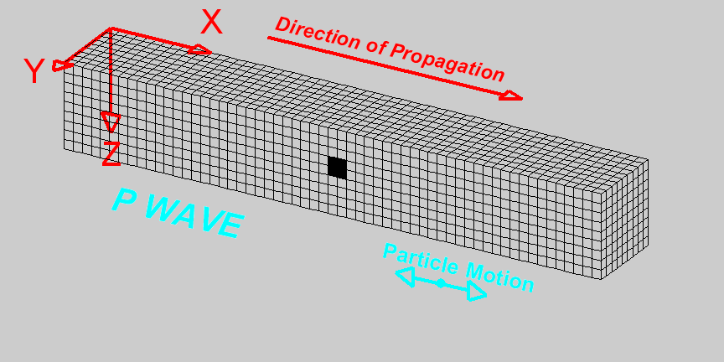
Body Waves
P waves
  – travel fast and the first (primary) seismic waves to reach an observer
http://www.tjhsst.edu/~jlafever/wanimate/Wave_Properties2.html
Notes:
Body Waves
Two main types
P waves – travel fast and the first (primary) seismic waves to reach an observer
Compressional elastic waves – alternate compression and expansion of a rock (spring)
Travel at 4 to 7 km per second in crust, ~8 km per second in the mantle
Sound travels through air at 0.34 km per second
Travel through air, liquid and solid material

Slide 13
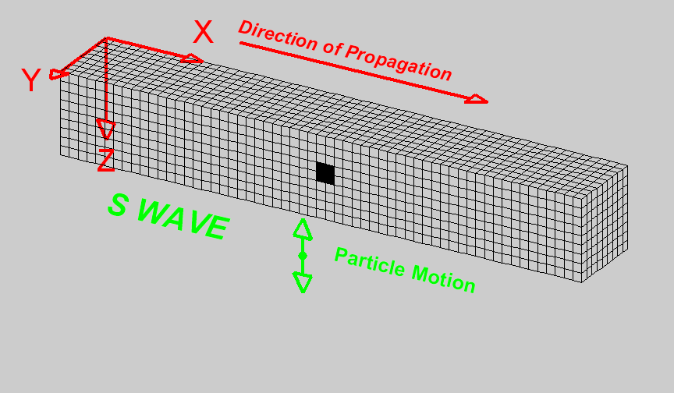
Body Waves
S waves
  slower and secondary seismic waves to reach an observer
http://www.tjhsst.edu/~jlafever/wanimate/Wave_Properties2.html
Notes:
S waves – slower and secondary seismic waves to reach an observer
shear waves – shearing motion (rope tied to wall and jerked up and down)
individual particles move at right angles to the wave
shake the ground at right angles to the direction in which the wave is moving
Travel at 3 to 4 km through the crust
Only through solids

Slide 14
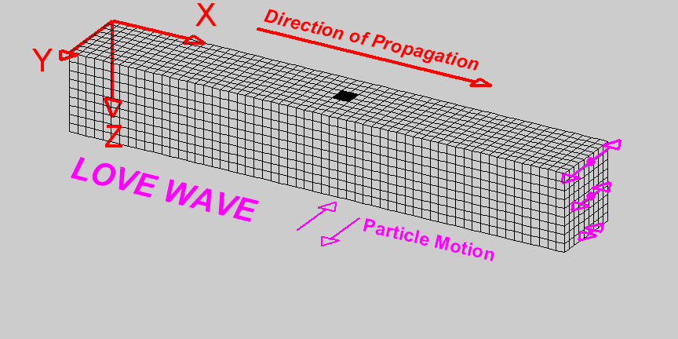
Surface Waves
Travel more slowly than body waves
Undulate ground
http://www.tjhsst.edu/~jlafever/wanimate/Wave_Properties2.html
Notes:
Surface Waves
Travel more slowly than body waves
Undulate ground
Side to side vibration

Slide 15
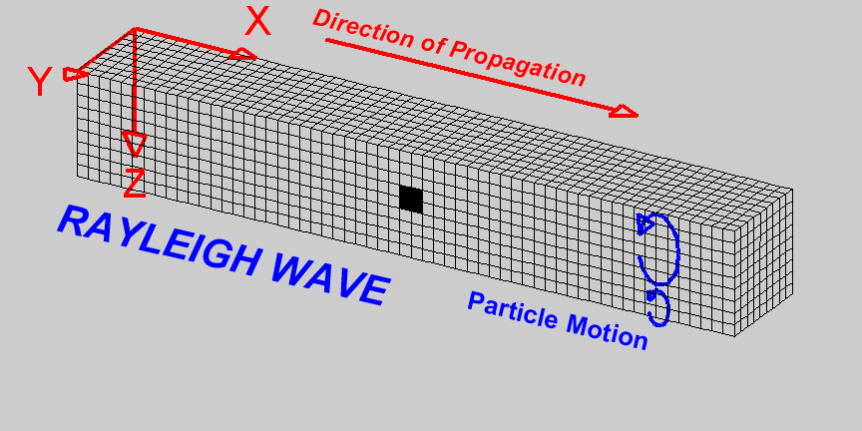
Surface Waves
Travel more slowly than body waves
Undulate ground
http://www.tjhsst.edu/~jlafever/wanimate/Wave_Properties2.html
Notes:
Up and down rolling motion
Principal source of movement and damage on surface

Slide 16
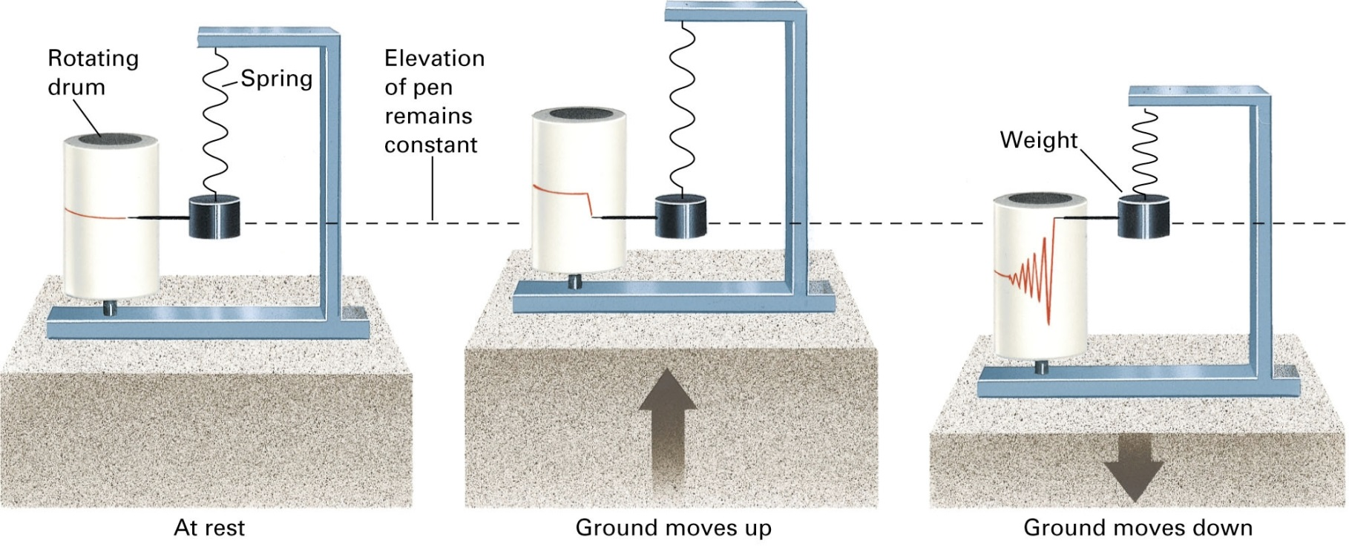
Measurement of Seismic Waves
Seismograph – records seismic waves
Notes:
Measurement of Seismic Waves
Seismograph – record seismic waves
Pen attached to weighted spring lined up at a zero mark on a roll of graph paper attached to bedrock – paper roll would move during an earthquake but inertia would keep weight and pen still
Creates seismogram

Slide 17
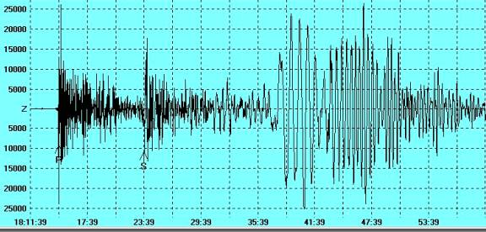
Seismogram
Notes:
Modern seismographs use electronic motion detectors and computers

Slide 18
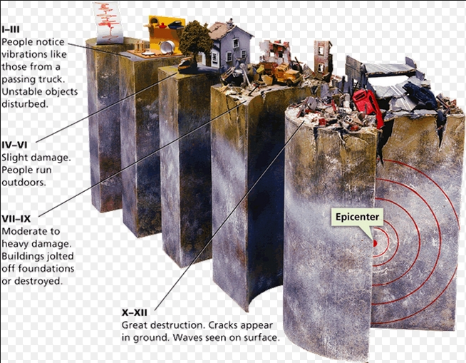
Measurement of
Earthquake Strength
Mercalli scale – based on structural damage
  Doesn’t accurately measure
  energy
Notes:
Measurement of Earthquake Strength
Created several scales to express strength
Mercalli scale – based on structural damage
Doesn’t accurately measure energy because damage depends on distance from the focus, rock/soil beneath the structure, quality of construction

Slide 19
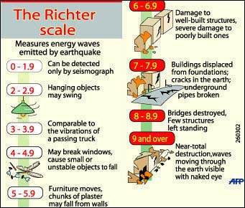
Measurement of
Earthquake Strength
Mercalli scale – based on structural damage
  Doesn’t accurately measure
  energy
Richter Scale – height of largest body wave
Notes:
Richter Scale (1935) – calculated from height of largest earthquake body wave on a specific type of seismograph
Not really precise – sharp quick movement vs. long shaking time

Slide 20
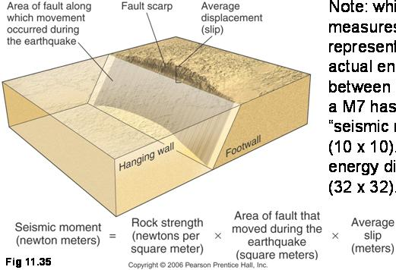
Measurement of
Earthquake Strength
Mercalli scale – based on structural damage
  Doesn’t accurately measure
  energy
Richter Scale – height of largest body wave
Moment Magnitude – amount of movement along and surface area of the fault that moved
Notes:
Moment magnitude – measure the amount of movement and surface area of the fault that moved
Energy of quake increases by a factor of 30 for each increment on the scale (Richter too) – so magnitude 6 releases 30 times more energy than a magnitude 5
Strength of rocks determines the size of a quake – strong rocks can store more elastic energy before it fractures than a weak rock

Slide 21
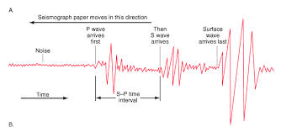
Locating the
Source of an Earthquake
P waves travel faster than S waves which travel faster than surface waves
Notes:
P waves travel fast than S waves which travel faster than surface waves – if a recording station is close, they will arrive in rapid succession, the further from the epicenter the station is the wave types will arrive further apart.

Slide 23

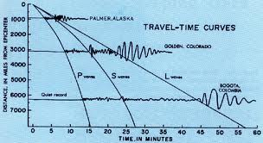
Time-Travel Curve
Calculate distance between an epicenter and a seismograph
Notes:
Time-travel curve – used to calculate the distance between an epicenter and a seismograph
Plot a known curve using data from known epicenters, then compare to data from unknown epicenters
In 1950s and 60s, used data from the seismic waves that resulted from atomic bomb tests to improve known time-travel curves, since they could verify the location and timing of the explosions

Slide 24
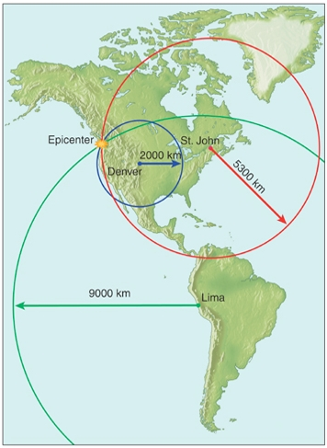
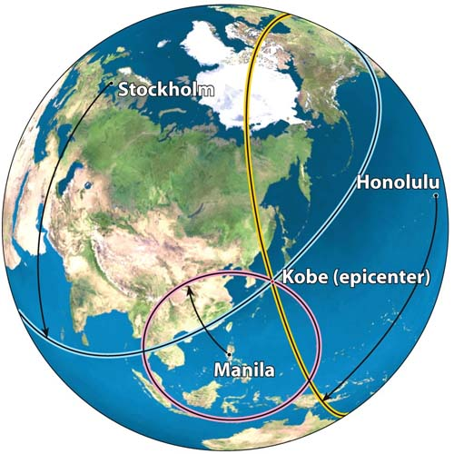
Verify Location
Use data from three or more recording stations
McGraw-Hill
Notes:
To verify location – use the data from three or more recording stations – circles drawn around the stations (distance = radius) will intersect at the epicenter

Slide 25
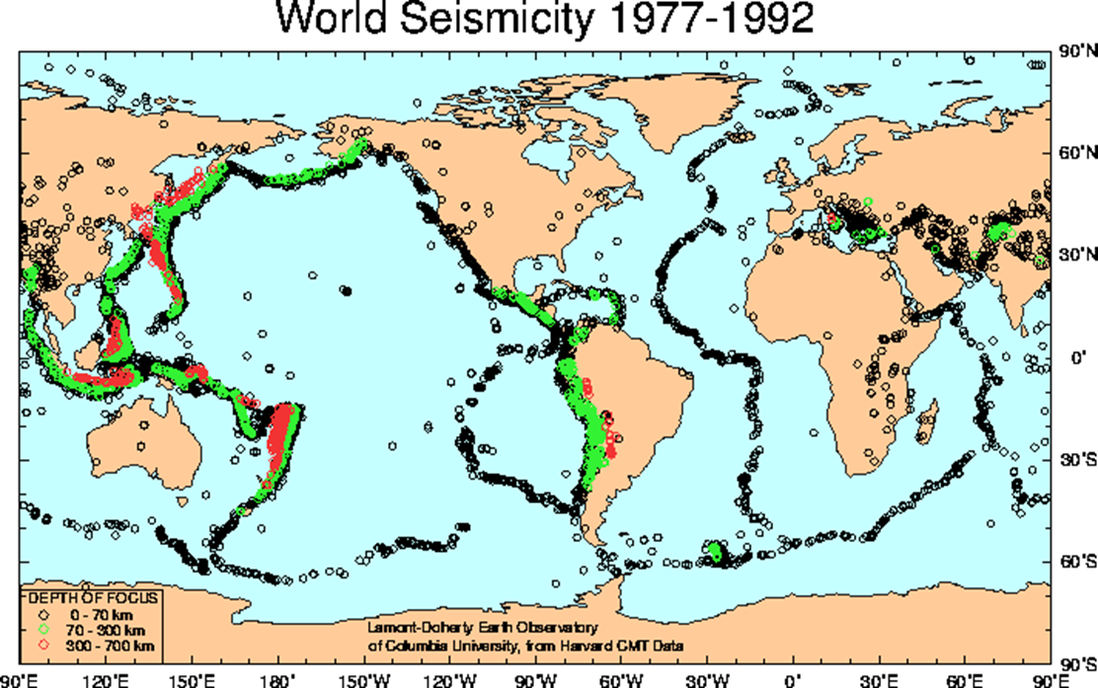
Earthquakes and
Tectonic Plate Boundaries
7.3
Notes:
7.3 Earthquakes and Tectonic Plate Boundaries
Before plate tectonic theory was developed, it was recognized quakes occurred frequently in some areas but not in others, know it is recognized that most occur along plate boundaries

Slide 26
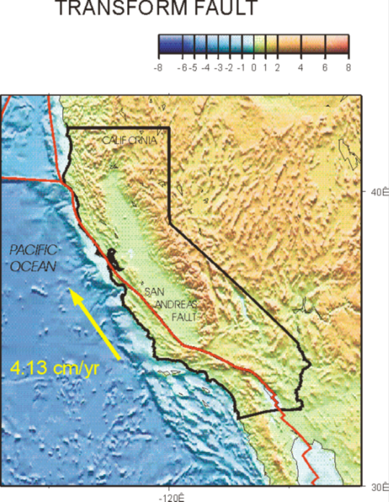
Earthquakes at a
Transform Plate Boundary
Transform boundary
  Strike-slip fault - fault is vertical, but rocks on opposite sides move horizontally
Notes:
Earthquakes at a Transform Plate Boundary: The San Andreas Fault Zone
San Francisco to San Diego straddles the San Andreas Fault Zone
Transform boundary between the Pacific plate and North American plate
Fault is vertical, but rocks on opposite sides move horizontally – strike slip fault
Plate motion stresses rocks adjacent to the fault, creating new, smaller faults – all part of the fault zone
Hundreds of thousands of earthquakes

Slide 27
% = probability of an earthquake with magnitude >5 in next 30 years
Notes:
Plates move in three different ways along the San Andreas
Fault creep – rocks slip past each other at a continuous, snail-like pace without sudden releases of energy that result in earthquakes
Some places the plates move in small hops, which causes numerous small earthquakes
Large amounts of friction in other areas build up lots of elastic energy as the rocks continue to move and deform without the fault slipping
Plates here move at an average of 3.5 cm per year (3.5 m every 100 years)
When accumulated energy exceeds the force of the friction , the rock suddenly slips along the fault and snaps back into its original shape, producing a large, destructive earthquake
Impossible to really predict the next “Big One”

Slide 28
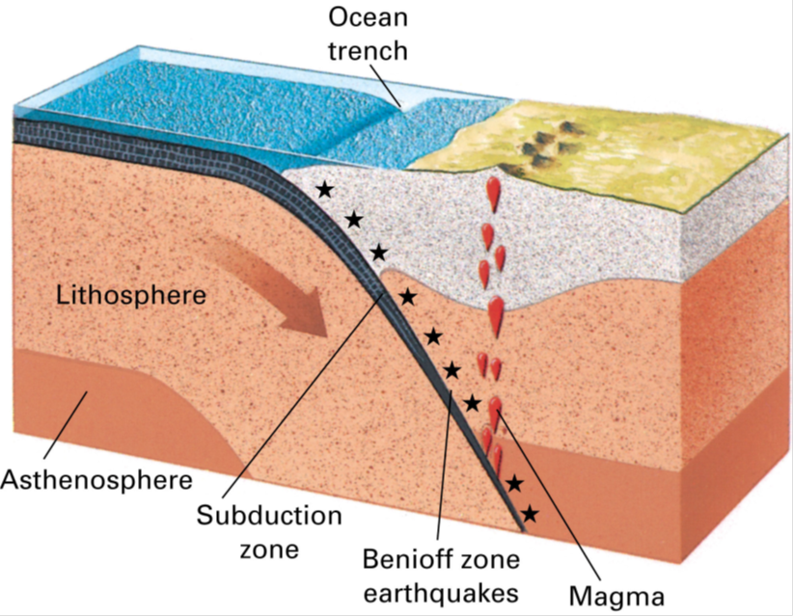
Earthquakes at a
Convergent Plate Boundary
Subduction zones
  Benioff Zone – friction causing an earthquake zone concentrated along the upper part of the subducting plate
Notes:
Earthquakes at Convergent Plate Boundaries
Subduction zones
Cold lithospheric plate slips under the plate above it in intermittent jerks
Benioff Zone – earthquake zone concentrated along the upper part of the subducting plate

Slide 29
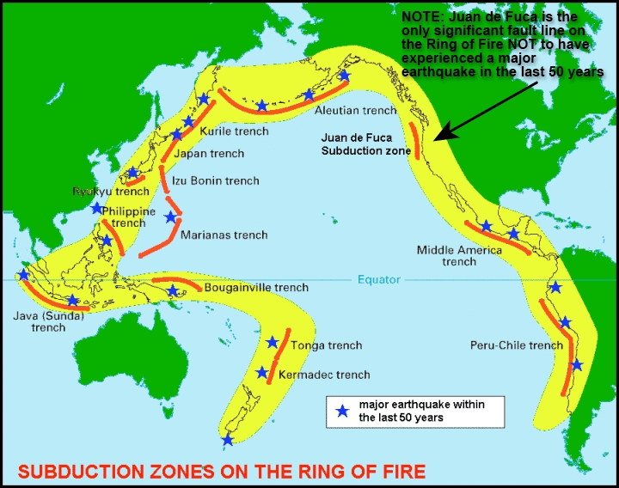
Notes:
Very strong earthquakes

Slide 30
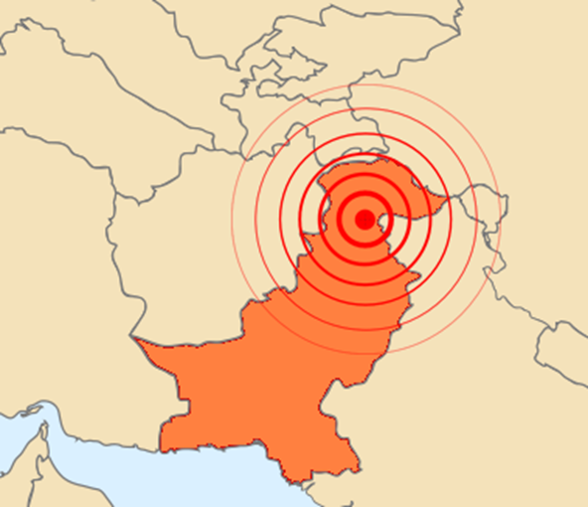
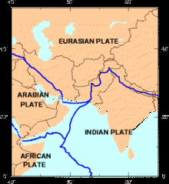
Earthquakes at A
Convergent Plate Boundary
Continent-Continent
  Crust buckles to form mountains – rocks fracture and slip generating frequent earthquakes
Notes:
Continent – Continent
Crust buckles to form mountains – rocks fracture and slip generating frequent earthquakes
2005 earthquake along the India-Pakistani border

Slide 31
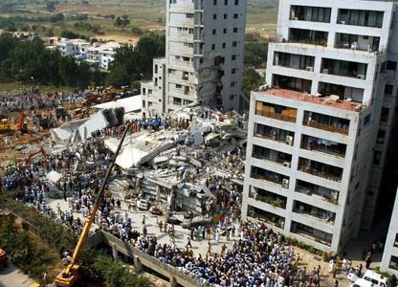
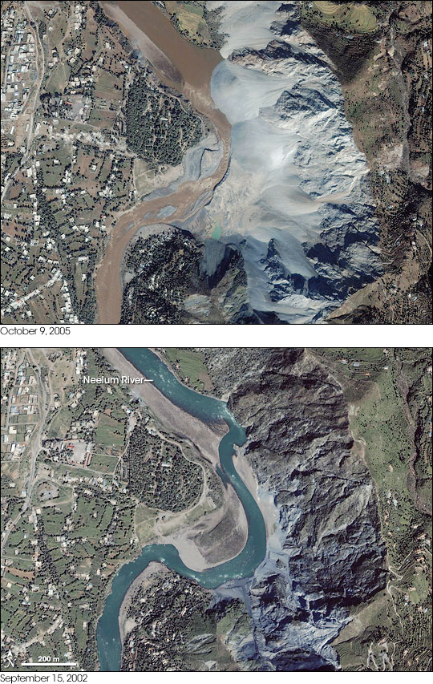
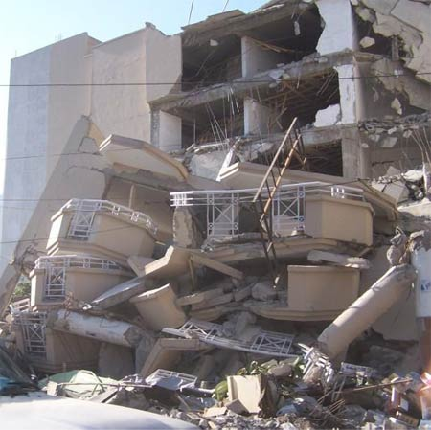
NASA
Notes:
(7.6 magnitude, 18th deadliest)

Slide 32
Earthquakes at A
Divergent Plate Boundary
Crust pulls apart and blocks fall downward, forming a rift valley
  Shallow earthquakes
Notes:
Earthquakes at Divergent Plate Boundaries
As crust pulls apart, blocks drop downward forming a rift valley
Shallow earthquake occur along mid-ocean ridges
Asthenosphere rises to such shallow levels (10 to 15 km) and it is too hot and plastic to fracture

Slide 33
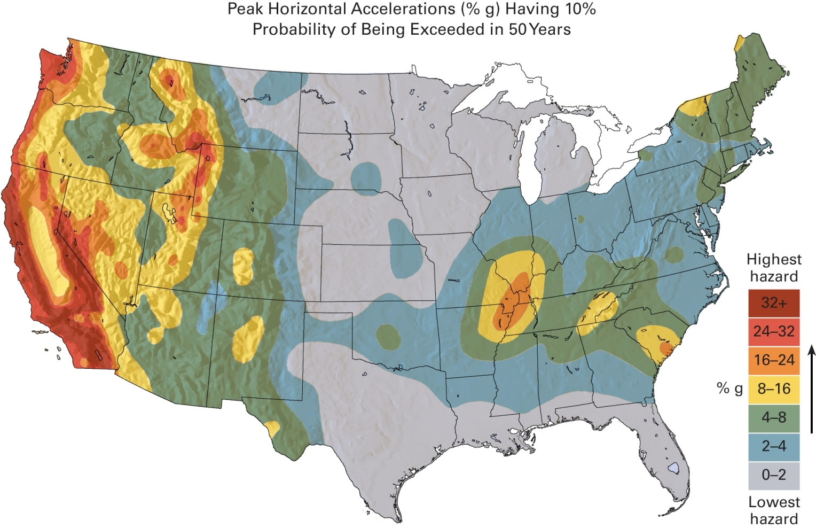
Earthquakes in Plate Interiors
Notes:
New Madrid, Missouri – largest historical earthquake sequence in the US
1811 and 1812, three shocks , estimated magnitudes of 7.3 to 7.8
Altered course of Mississippi River and rang church bells in DC
Tectonic forces stretched the North American plate in the Precambrian which created two crisscrossing fault zones that failed to developed into an active rift/divergent plate boundary – that’s centered over New Madrid
As North American plate travels over the asthenosphere, irregularities can cause slippage and earthquakes along the deep faults
Rocks are deforming adjacent to the New Madrid faults about as fast as rock along active tectonic plate margins – points to more earthquakes in the future

Slide 34
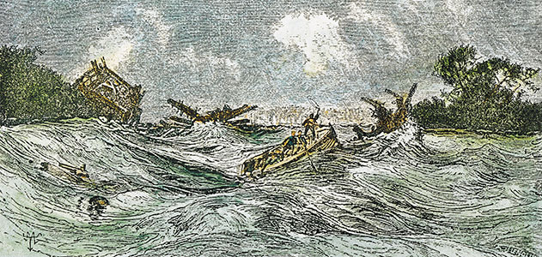
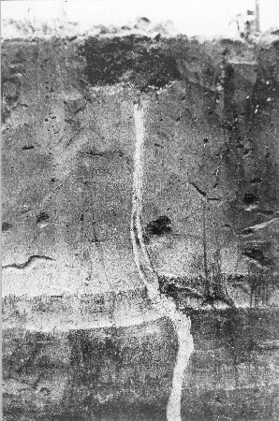
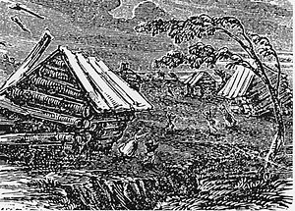
Smithsonian
USGS
Notes:
The Midwest was sparsely populated, and deaths were few. But 8-year-old Godfrey Lesieur saw the ground “rolling in waves.” Michael Braunm observed the river suddenly rise up “like a great loaf of bread to the height of many feet.” Sections of riverbed below the Mississippi rose so high that part of the river ran backward. Thousands of fissures ripped open fields, and geysers burst from the earth, spewing sand, water, mud and coal high into the air.
http://www.smithsonianmag.com/science-nature/The-Great-Midwest-Earthquake-of-1811.html

Slide 35
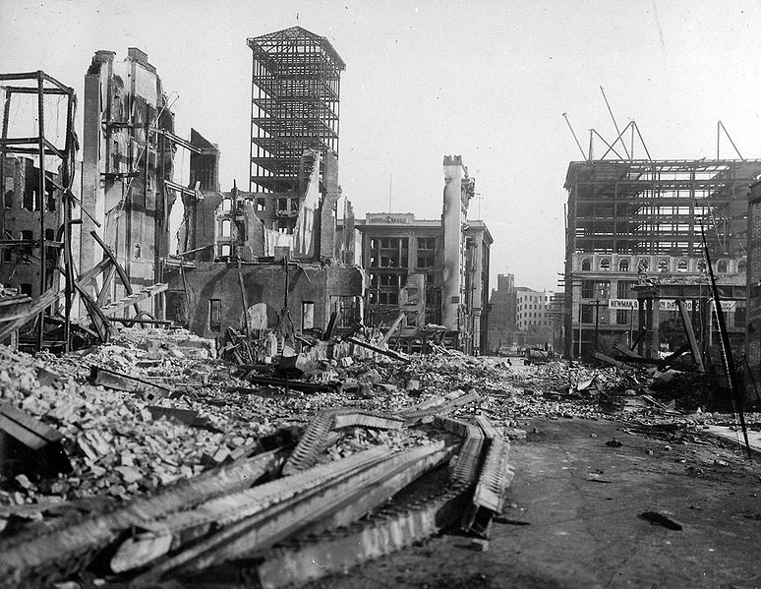
Earthquake Prediction
7.4
San Francisco, 1905

Slide 36
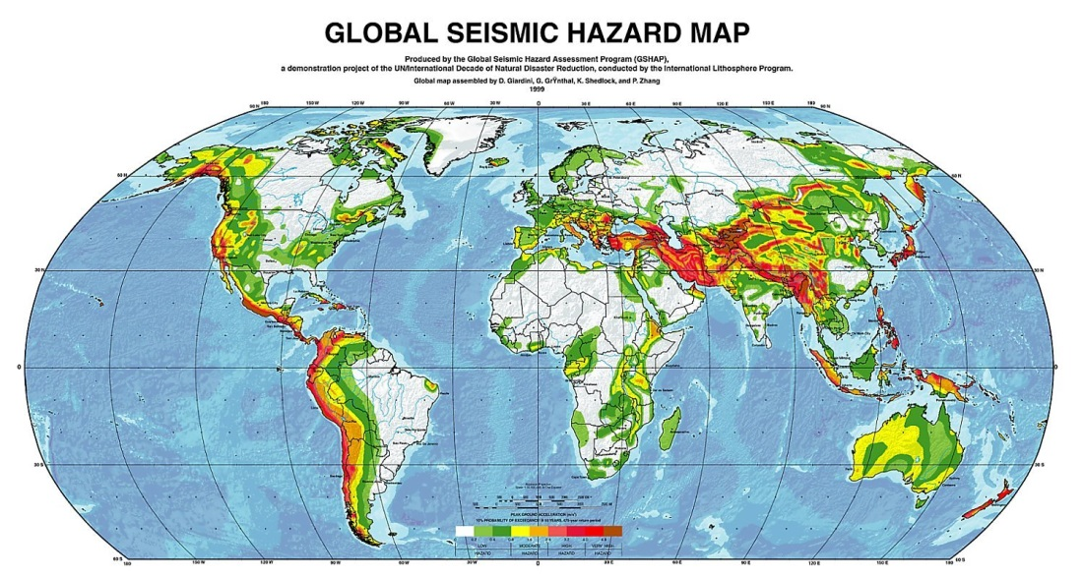
Long-Term Prediction
Notes:
Long-Term Prediction
Recognizing that earthquakes have occurred many times along existing faults and will probably occur again
Most active along the West Coast due to plate boundaries
Tells us where
Establish building codes
Only a vague idea of when

Slide 37
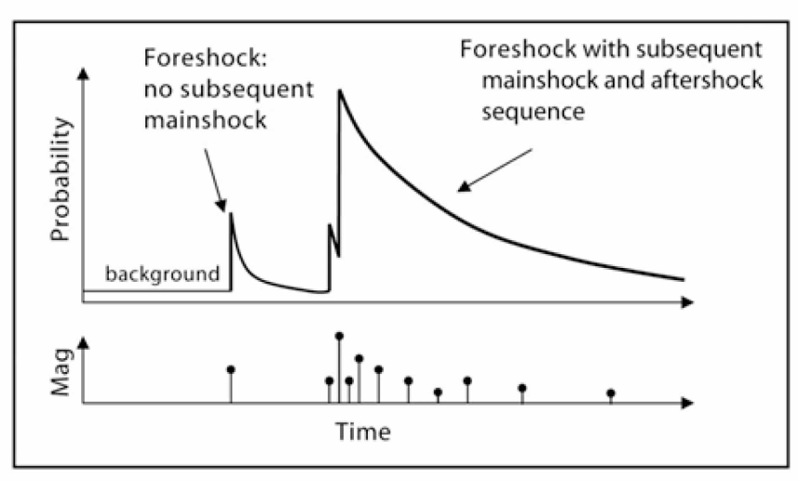
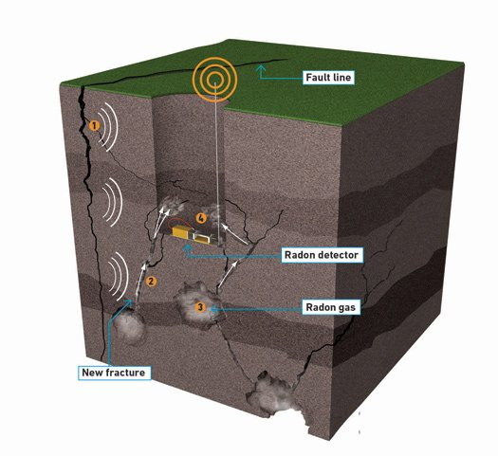
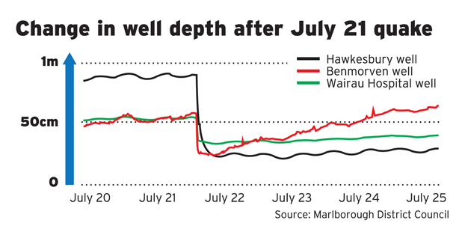
Short-Term Prediction
Depends on signals that immediately precede and earthquake
  Foreshocks
  Changes in land surface
  Radon gas
  Well levels
Notes:
Short-Term Prediction
Depends on signals that immediately precede an earthquake
Foreshocks – small earthquakes that precede a larger one by seconds to weeks
Not reliable, they only precede about half of large earthquakes
Swarms of small shocks can occur without a large quake afterwards
Measure changes in land surface around active fault zones to monitor crustal distortions
Still not very reliable
Radon gas levels can increase
Well levels can fluctuate
Reliable method of short term prediction being searched for, but remains elusive

Slide 38
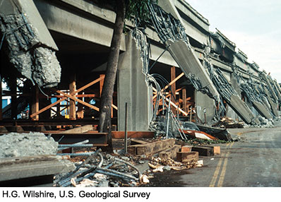
Earthquake Damage and
Hazard Mitigation
San Francisco Bay area after the 1989 Loma Prieta earthquake
7.5
Notes:
Most injuries and fatalities occur due to falling structures
Depends on magnitude of the quake, proximity to populations centers, rock and soil types, topography and quality of construction

Slide 39

How Rock and Soil
Influence Earthquake Damage
Bedrock tends to deform elastically
  Will return to original shape after quake
  If structures can withstand shaking, bedrock can be a desirable foundation
Notes:
Bedrock tends to return to its original shape after a quake – in regions where bedrock is near/at the surface, if structures are built to withstand the (often violent) shaking, it can be a desirable foundation

Slide 40
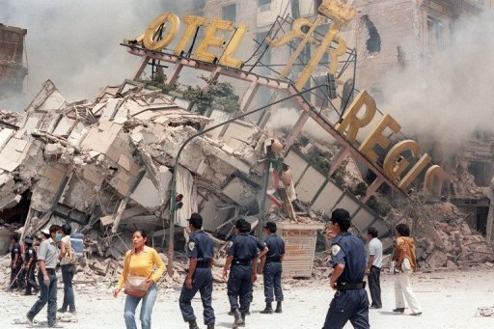
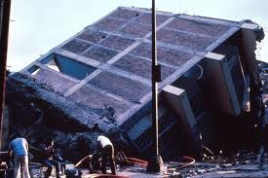
How Rock and Soil
Influence Earthquake Damage
Sand, silt and clay commonly settle during a quake
LA Times
Notes:
Sand, silt and clay commonly settle during a quake and the displacement of the sediment tilts building, breaks pipelines and roadways, fractures dams
Avert structural failure, steel pilings are driven through the soil to the bedrock to anchor structures
Mexico City – 1985, 8.1 quake built on clay rich soil and ringed by mountains
Seismic waves shook city and reflected off the mountains, amplifying the waves
Destroyed over 500 buildings and killed between 8,000 and 10,000 people
Acapulco had relatively little damage – built on bedrock

Slide 41
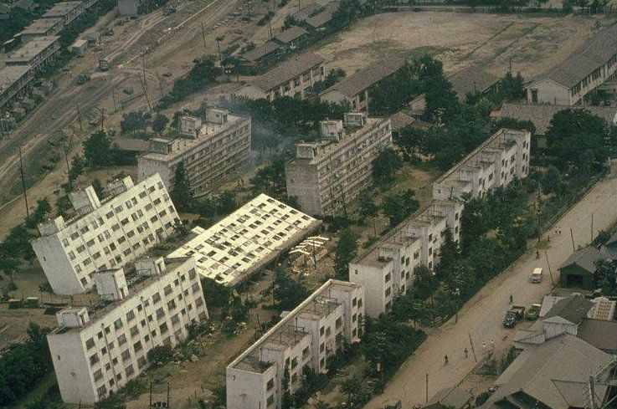
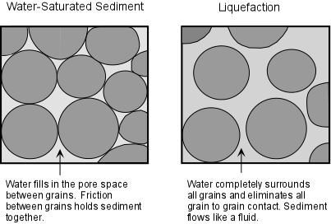
How Rock and Soil
Influence Earthquake Damage
Landslides
Niigata in 1964
Notes:
Landslides – if soil is saturated with water, the pore pressure may rise enough to suspend the grains and the soil loses its shear strength (resistance to being pulled apart) and behaves like a fluid – liquefaction

Slide 42
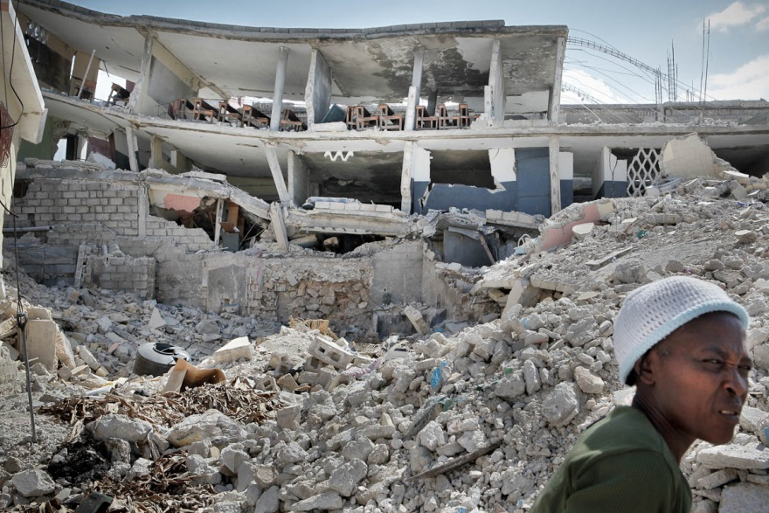
Construction Design and Earthquake Damage
Quality of construction
  Steel and wooden framing materials bend and sway but resist failure while unframed masonry will collapse
Earthquake mortality is tied to economic systems
Haiti, 2010

Slide 43
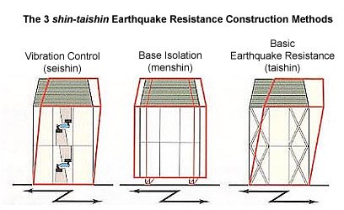
http://japanpropertycentral.com/real-estate-faq/earthquake-building-codes-in-japan/
Notes:
Japanese building codes
Taishin – basic earthquake resistance
Beams, pillars, walls are thicker to provide more strength
No dampening system, so structure takes the brute force
Shaking feels more violent to those inside; the higher the floor, the more violent the shaking
Greater possibility for damage to items inside and to building itself
Seishin – optional
Vibration control
Dampers absorb energy from the quake and reduce shaking
Menshin – optional, most expensive
Base isolation system
Structure is isolated from the ground so shaking is much slower and gentler

Slide 44
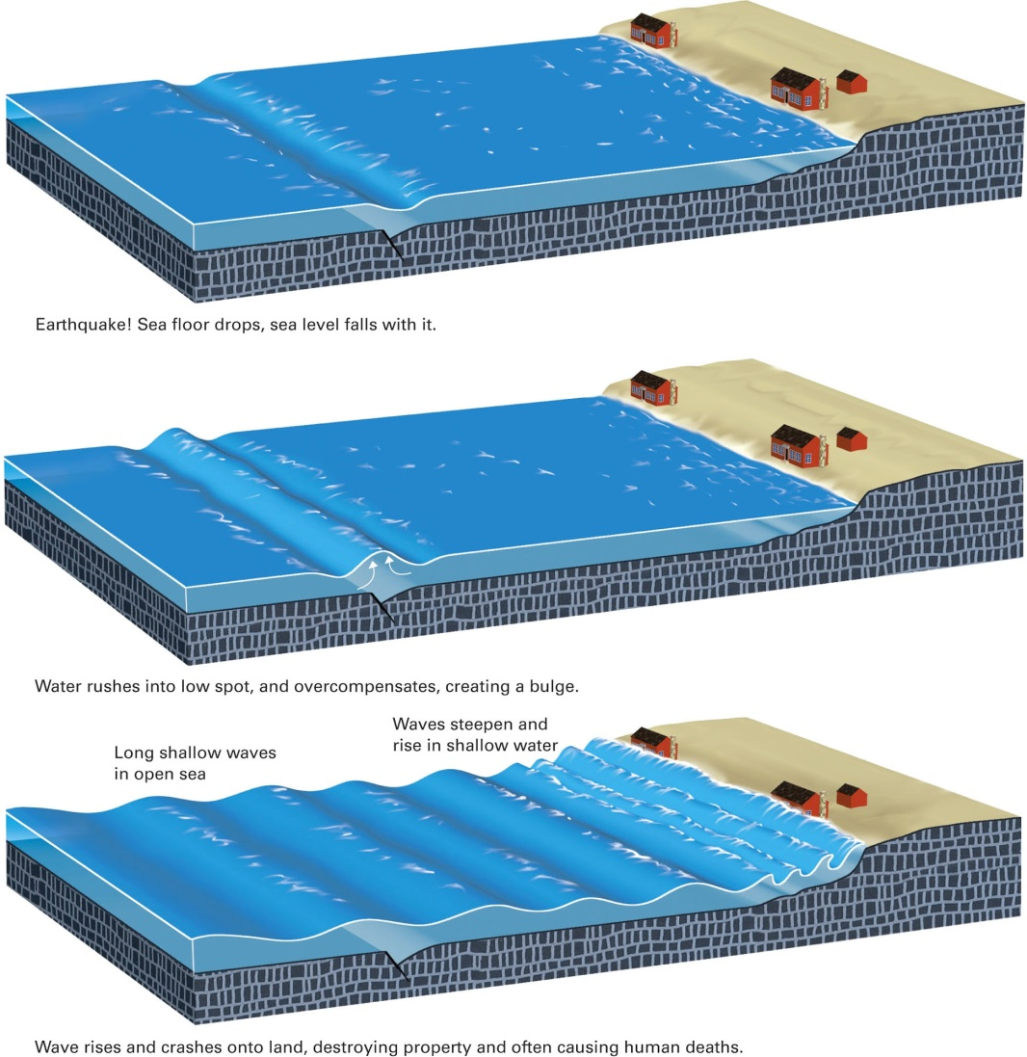


Tsunamis
Undersea earthquakes cause the sea floor to rise and fall and water is displaced in response to the rock movement, forming a wave
Notes:
Tsunamis
Undersea earthquakes cause the sea floor to rise and fall and water is displaced in response to the rock movement, forming a wave
Deep water the crest may be only 1 to 3 m high, with crests 100 to 150 km apart
Can travel at 750 km an hour (~466 mph)
Shallow water, the base of the wave drags along the sea floor and the water piles up, increasing wave height, which then flows inland

Slide 45


Slide 46



Notes:
2004 tsunami
Section of the Indian-Australian plate is subducting under Sumatra and Java
1,200 km of seafloor along the subducting plate slipped with a vertical movement of up to 15m
9.0 to 9.3 earthquake lasted about ten minutes and initiated a tsunami that radiated in all directions
Coastal waters retreated, exposing mud in ocean bays, then the wave raced inward, rearing as much as 30 m (10-story building)
Killed an estimated 283,000 people along the coastlines of the Indian Ocean
Early warning system
Barrier islands and coastal reefs tend to break up the waves

Slide 47

Studying the
Earth’s Interior
7.6

Slide 48

Behavior of Seismic Waves
1. In a uniform, homogeneous medium, a wave radiates outward in concentric spheres and at a constant velocity

Slide 49

Behavior of Seismic Waves
2. The velocity of the seismic wave depends on the nature of the material that it travels through.
www.epa.gov

Slide 50


Behavior of Seismic Waves
3. When a wave passes from one material to another, it refracts (bends) and sometimes reflects (bounces back).

Slide 51

Behavior of Seismic Waves
4. P waves are compressional waves and can pass through gases, liquids, and solids. S waves are shear waves and travel only through solids.

Slide 52

Discovery of the
Crust-Mantle Boundary
Direct waves travel through the crust, while refracted waves travel down through the mantle then refract back upwards
  Seismic waves travel faster in mantle
  Distance from focus will determine order of arrival for waves
Fig 7.21
Notes:
Discovery of the Crust-Mantle Boundary
Fig 7.21
Some waves travel through the crust, some travel downwards into mantle and then refract back upwards
Route through mantle is longer, but seismic waves travel faster through the mantle than the crust
Over a short distance, the waves through the crust will arrive at a seismograph first
For longer distances, the waves travelling through the mantle will arrive first at the further seismograph

Slide 53


Discovery of the
CRUST-mantle Boundary
1909, Andrija Mohorovicic analyzed seismic wave arrival times at different seismographs and identified the core-mantle boundary
  Mohorovicic discontinuity (Moho)
Notes:
1909, Andrija Mohorovicic discovered waves from more distant earthquakes traveled faster than those from a nearby quake. Analyzing arrival times of seismic waves to from different quakes to different seismographs allowed him to identify the core-mantle boundry – the Mohorovicic discontinuity – the Moho
Moho lies at a depth from 4 to 70 km (oceanic crust is thinner than continental crust)

Slide 54

The Structure of the Mantle
2,900 km thick and 80% of Earth’s volume
Knowledge of composition and structure comes from seismic data
Notes:
The Structure of the Mantle
2,900 km thick and 80% of Earth’s volume
Knowledge of composition and structure comes from seismic data
Seismic waves speed up abruptly at core mantle boundary
Slow when they enter the asthenosphere
Speed up again as pressure overwhelms temperature and the mantle rock increases in strength
660-kilometer discontinuity – pressure is great enough that minerals in the mantle react to form denser minerals, seismic wave velocity increases

Slide 55

Discovery of the Core
Can detect P and S waves up to 105 degrees from focus
Between 105 and 140 degrees is a “shadow zone”
  Core-mantle boundary where P waves are refracted/bent away from the shadow zone
No S-waves arrive beyond 105 degrees
  They do not travel though the liquid outer core
Refraction patterns of P waves indicate another boundary exists within the core (liquid outer to solid inner)
Notes:
Discovery of the Core
Use a global array of seismographs
Can detect P and S waves up to 105 degrees from focus
Between 105 and 140 degrees is a “shadow zone”
Core-mantle boundary where P waves are refracted/bent away from the shadow zone
No S-waves arrive beyond 105 degrees
They do not travel though the liquid outer core
Refraction patterns of P waves indicate another boundary exists within the core (liquid outer to solid inner)

Slide 56

Notes:
Studies in the 80s and 90s, show that seismic waves travel at different speeds in different directions in the inner core
So the inner core isn’t homogenous
Rotating significantly faster than mantle and crust
Inner core has its own convection

Slide 57


Slide 58

Density Measurements
Notes:
Density is equal to the mass of an object divided by its volume.
Henry Cavendish calculated the mass (and thus the density) of the Earth by performing the Cavendish Experiment (1797-98).
Suspended metal rod with two lead balls attached and placed masses of metal near them in order to measure the force of attraction (faint gravitational attraction).

Slide 59

Density Measurements
Overall density of Earth is 5.5 g/cm3
  Crust - 2.5 to 3 g/cm3
  Mantle - 3.3 to 5.5 g/cm3
    Crust and mantle are over 80% of Earth’s volume, so core must be very dense to account for average density of Earth
  Core density is calculated to be between 10 to 13 g/cm3
Meteorite Cross Section
Notes:
Overall density of Earth is 5.5 g/cm3
Crust - 2.5 to 3 g/cm3
Mantle - 3.3 to 5.5 g/cm3
Crust and mantle are over 80% of Earth’s volume, so core must be very dense to account for average density of Earth
Core density is calculated to be between 10 to 13 g/cm3
Cosmologists think that Fe-Ni meteorites formed at same time as solar system
Earth coalesced from meteorites and similar objects, Fe and Ni should be abundant on Earth and within the core

Slide 60

Earth’s Magnetism
7.7
Notes:
Early navigators saw that no matter where they were a needle-shaped magnet aligned itself approximately north-south – Earth has a magnetic north pole and magnetic south pole

Slide 61

Earth’s Magnetism
Probably electromagnetic
Generated in the liquid, metallic outer core
  Convection
  Deflection
Other planets have fields as well
Notes:
Interior is too hot for a permanent magnet, so magnetic field is probably electromagnetic in origin
Field is probably generated within the liquid, metallic outer core
Hotter at base than surface, so convection occurs
Rising and falling metals are then deflected by Earth’s spin, generating the electromagnetic field

