Slide 1
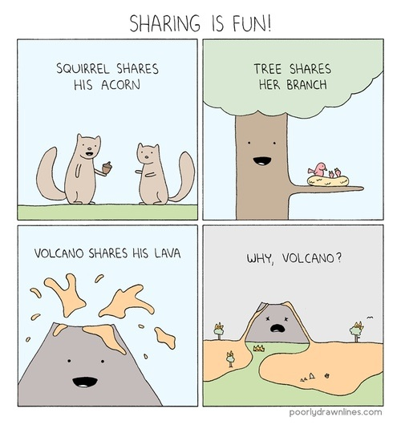
Volcanoes and Plutons
Chapter 8

Slide 2
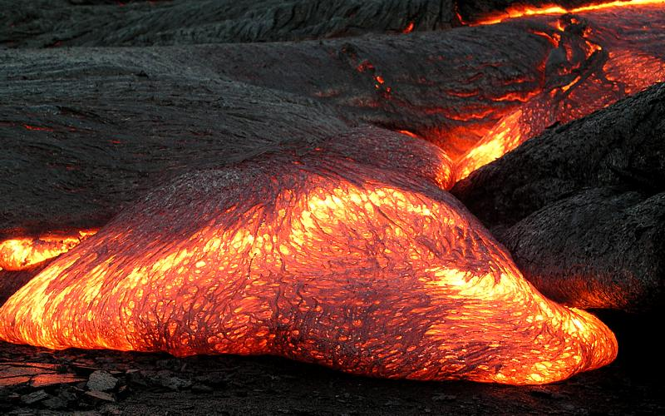
Magma
8.1

Slide 3
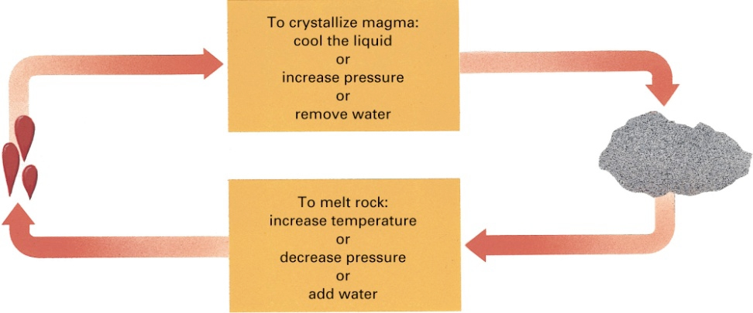
Processes that form Magma
Asthenosphere
Combined effects of temp and pressure cause plastic flow
Only 1 to 2% is molten
Majority is solid rock very close to its melting point
Increasing temperature
Decreasing pressure
Addition of water
Notes:
Processes that form Magma
Asthenosphere – layer in upper mantle that extends from a depth of ~100 to 350 km
Combined effects of temp and pressure cause plastic flow and deformation and about 1 to 2% is molten
Majority is solid rock but so hot and so close to its melting point that relatively small changes can melt large volumes of rock
Increasing temp
Decreasing pressure
Addition of water

Slide 4
Increasing Temperature
Solids melt when they become hot enough
Notes:
Increasing Temperature
Solids melt when they become hot enough
Increases in temp will melt a hot rock but it’s least important cause of magma formation in the asthenosphere

Slide 5
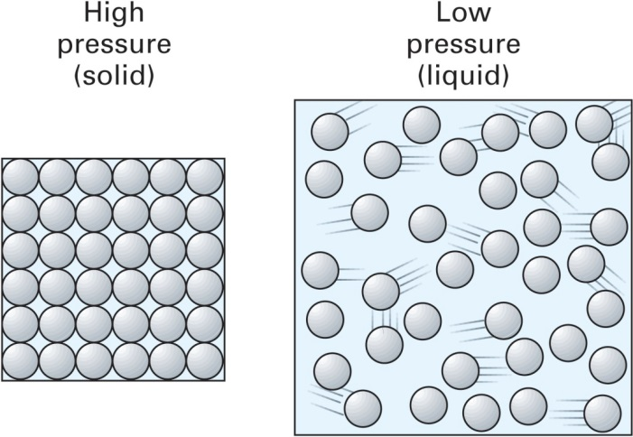
Decreasing Pressure
Melting increases the volume of rock by ~10%
Decreases density
Increased pressure prevents expansion and prohibits melting
Pressure-release melting
Notes:
Decreasing Pressure
As rocks and minerals melt, their volume increases about 10% (so density decreases)
On the surface, at 1 atm of pressure, there’s not enough pressure to keep it from expanding/melting
In the asthenosphere, the temp is hot enough to melt rock but pressure keeps it’s from expanding, so it doesn’t melt
If pressure were to decrease, large amounts of asthenospheric rocks would melt to form magma
Pressure-release melting

Slide 6
Addition of Water
Water will lower the melting temperature of rock
Notes:
Addition of Water
Water can lower the melting temperature of rocks
Rocks with small amounts of water will melt at lower temps than an otherwise identical dry rock
Certain tectonic processes add water to the hot asthenosphere to form magma

Slide 7
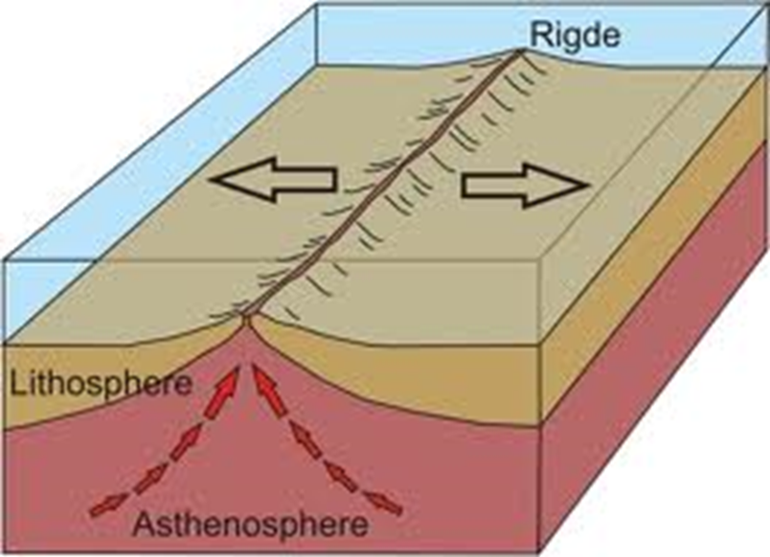
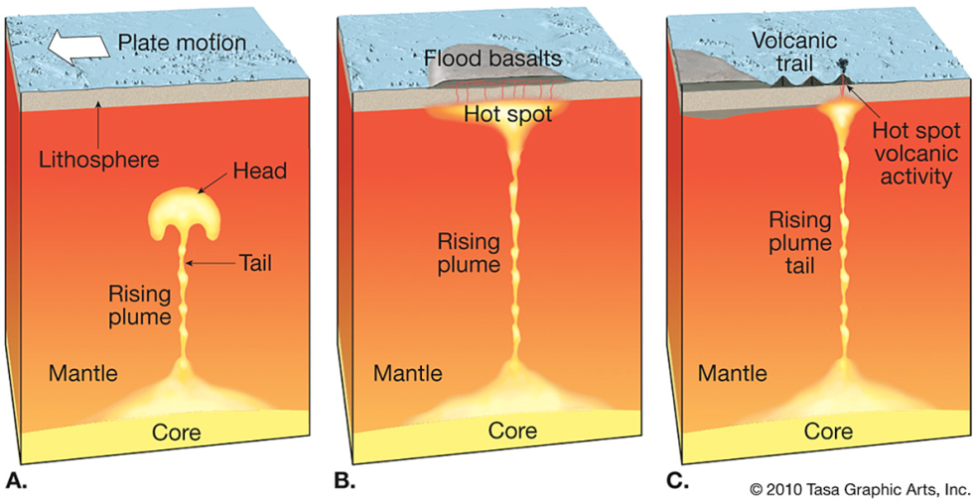
Environments of Magma Formation
Magma forms abundantly in three tectonic environments
Spreading centers
Mantle plumes
Subduction zones

Slide 8
Magma Production in a Spreading Center
Lithospheric plates separate and hot asthenosphere oozes upward
Pressure-release melting form basaltic magma
Notes:
Magma Production in a Spreading Center
Lithospheric plates separate and hot, plastic asthenosphere oozes upward
As the asthenosphere rises, pressure drops and pressure-release melting forms basaltic magma
Lower density magma rises to the surface
Most spreading centers in oceans – form the mid-ocean ridge system
Erupting magma solidifies to form new oceanic crust, which then spreads outward
Most oceanic crust is created this way

Slide 9
Magma Production in a Mantle Plume
Rising column of hot, plastic rock from core-mantle boundary
Pressure-release melting just under the lithosphere
Notes:
Magma Production in a Mantle Plume
Rising column of hot, plastic rock that originates near the core-mantle boundary
Rises because it’s hotter than the surrounding magma (so less dense, more buoyant)
Pressure-release melting form magma just under the lithosphere

Slide 10
Hot Spot Locations
USGS
Notes:
Usually occur within tectonic plates
Yellowstone – volcanoes and hot springs
Hawaii – volcanic eruptions build submarine volcanoes and volcanic islands

Slide 11
Hot Spots: Oceans vs. Continents
Hawaiian Hot Spot
Yellowstone Caldera Chain
Geology.com
Geology.com
www.cotf.edu

Slide 12
Magma Production in a Subduction Zone
Addition of water
Decreasing pressure
Heat from friction
Notes:
Magma Production in a Subduction Zone
Addition of water, decreasing pressure, heat from friction all combine to create huge quantities of magma (magma forming from asthenosphere NOT subducting plate)
Subducting plate covered by water-saturated oceanic crust – rising temp vaporizes the water that ascends into the hot asthenosphere above the sinking plate
Subducting plate causes small amounts of convection as it drags asthenosphere down from friction
Pressure decreases as the hot rock rises
Friction generates heat as one plate scrapes against the other
Volcanoes and plutonic rocks are common features in subduction zones

Slide 13
Ring of Fire
Notes:
Ring of Fire
~75% of Earth’s active volcanoes (exclusive of MOR volcanoes) lie in the Ring of Fire

Slide 14
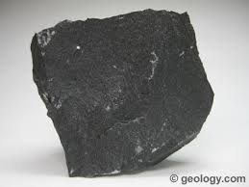
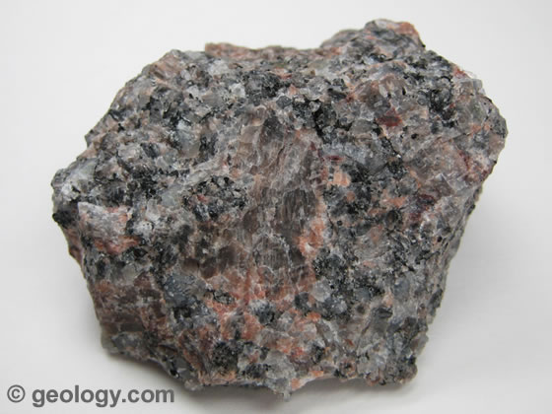
Basalt and Granite
8.2
Basalt
Granite
Notes:
Two most common igneous rocks
Basalt makes up most of oceanic crust
Granite makes up most of continental crust

Slide 15
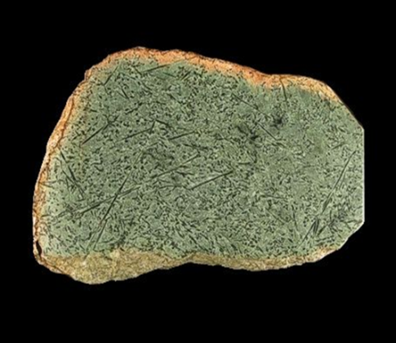
Melting the Mantle to form Oceanic Crust
Peridotite in the asthenosphere melts to form basaltic magma
Partial Melting
and
recrystallization
Peridotite
40% silica
Basalt
50% silica
Notes:
Peridotite in the asthenosphere melts to form basaltic magma (which solidifies into basalt)
Peridotite – 40% silica, ultra-mafic (very Fe and Mg-rich)
Basalt – 50% silica, mafic
So, why does the magma have a different composition than the rock it comes from?
Pure minerals will melt at higher temperature than mixture of minerals
Peridotite
Pure olivine – 1890 degrees C
Pure pyroxene – 1390 degrees C
Pure Ca-feldspar – 1550 degrees C
Rock – 1270 degrees C
Composition of first bit of melt from partial melting is usually richer in silica (about 20%) than peridotite
Only a small amount of the original peridotite melts, leaving silica depleted rock in the mantle, while the less dense basaltic magma rises to the crust

Slide 16
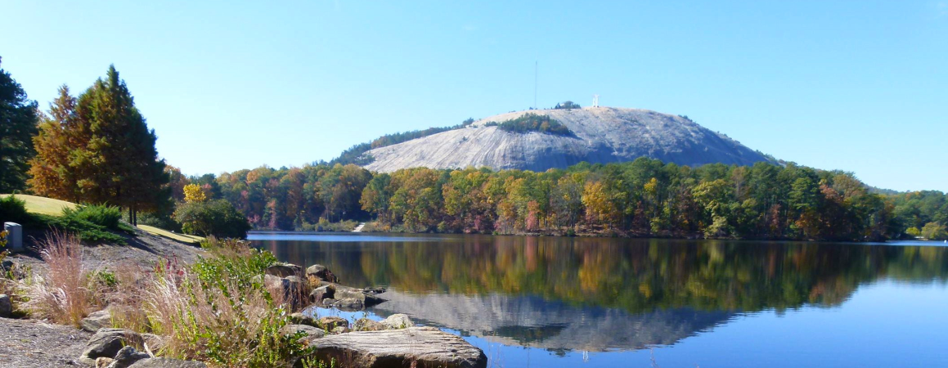
Granite and Granitic Magma
Contains more silica than basalt so melts at lower temp
700 – 900º C
Basaltic magma is hot enough to melt granitic continental crust
Stone Mountain, GA
Notes:
Granite and Granitic Magma
Contains more silica (~70%) than basalt so melts at a lower temp
Between 700 and 900 degrees C
Basaltic magma is hot enough to melt granitic continental crust
Since lower continental crust is already hot, even small amounts of basaltic magma will melt large amounts of continental crust to form granitic magma
Rises a short distance and the solidifies into a pluton
5 to 20 km
Continental margins, continental rift zones, mantle plumes

Slide 17
Andesite and Intermediate Magmas
The andesitic Lascar volcano in Chile is one the most active stratovolcanos in the central Andes.
Courtesy of Peter Francis.
Notes:
Andesite and Intermediate Magmas
Form same way as granitic magmas
Melting continental crust lower in silica or basaltic magmas mixed with granitic magmas

Slide 18
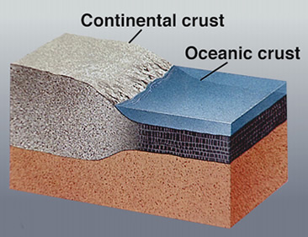
Partial Melting and the Origin of the Continents
8.3
USGS

Slide 19
Primordial Earth
Artist sketch via spaceart
Notes:
Earth was a molten ball shortly after it formed 4.6 billion years ago
First crust formed from peridotitic lavas
1) When did granitic continents form?
2) If the early crust and mantle were composed of peridotite, how did continental crust evolve?

Slide 20
When Did Continents Form?
3.96 billion year old Acasta Gneiss, Canada, Northwest Territory
Sandstone in Western Australia containing 4.4 billion year old zircons
Notes:
When Did Continents Form?
3.96 billion year old Acasta gneiss in Canada’s Northwest Territories among the oldest known rocks on Earth
Metamorphosed granitic rock, similar to modern continental crust
Implies some continental crust had formed by the early Precambrian
Zircons in sandstone from Western Australia
Radiometric dates of 4.4 billion years (sandstone is much younger)
Common mineral in granite – weathered from an older granite, released as sand, then lithified into the younger sandstone
Granite existed 4.4 billion years ago

Slide 21
Mantle (peridotite) | Oceanic Crust (basalt) | Continental Crust (granite)
High Mg and Fe | Less Mg and Fe | Low Mg and Fe
Low silica (~40%) | More silica (~50%) | High silica (~70%)
Notes:
We have to describe how oceanic and continental crust formed from mantle rocks

Slide 22
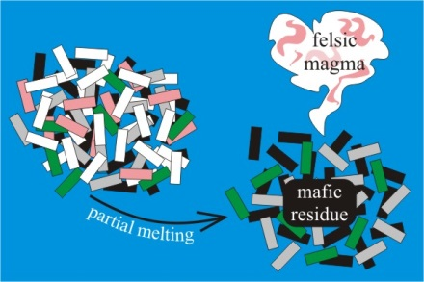
Partial Melting and the Origin of Granitic Continents
Peridotite in the asthenosphere melts to form basaltic magma
Callan Bentley
Notes:
Partial Melting and the Origin of Granitic Continents
Partial melting of peridotite forms a magma that that has a higher percentage of silica than the rock it forms from
Peridotite partial melts to basalt

Slide 23
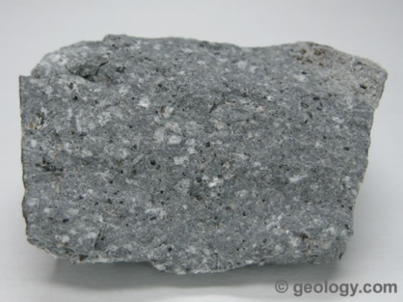
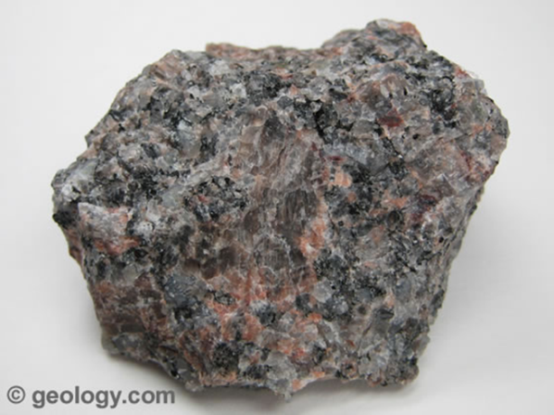
Partial Melting
Silicia-rich continents formed/evolved in steps from the silica-poor mantle
Peridotite
~40% silica
Andesite
~60% silica
Partial Melting
and
recrystallization
Basalt
~50% silica
Granite
~70% silica
Notes:
Peridotite partial melts to basalt
Basalt partial melts to andesite/diorite
Andesite partial melts to form rhyolite/granite
Silicia-rich continents formed/evolved in steps from the silica-poor mantle

Slide 24
What tectonic processes formed the first continents?
Magma forms abundantly in three tectonic environments
Spreading centers
Mantle plumes
Subduction zones
Notes:
What tectonic processes?
Magma/melting occurs at
Spreading centers
Subduction zones
Mantle plumes
Two hypotheses: Observations imply that similar horizontal tectonics could have been occurring in the Archean (magma forming at spreading centers and subduction zones), while other evidence suggests that plate motion was minor and mantle plumes dominated

Slide 25
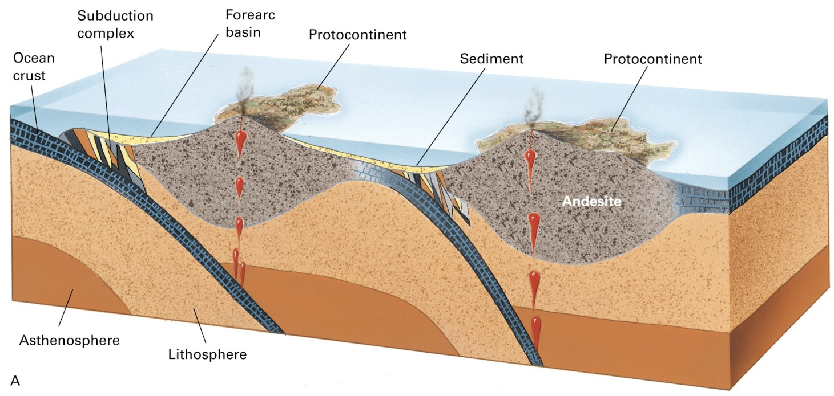
Horizontal Tectonics
Heat-driven convection currents in mantle drove plate movement
Dense primordial crust was subducted and partial melting created basaltic crust
Eventual subduction of the basaltic crust resulted in partial melting and the formation of more intermediate to granitic magmas
Notes:
Horizontal Tectonics
Heat-driven convection currents drove horizontal plate movement and dense, primordial crust was subducted into the mantle where partial melting created basaltic magmas, eventually the crust gradually became basaltic
As basaltic crust started to be subducted, partial melting created the earliest continental crust
First pieces of continental crust probably formed in small granitic or andesitic island arcs
Plate movement let to further subduction and the isolated islands began to form microcontinents
Sediments accumulated and were metamorphosed

Slide 26
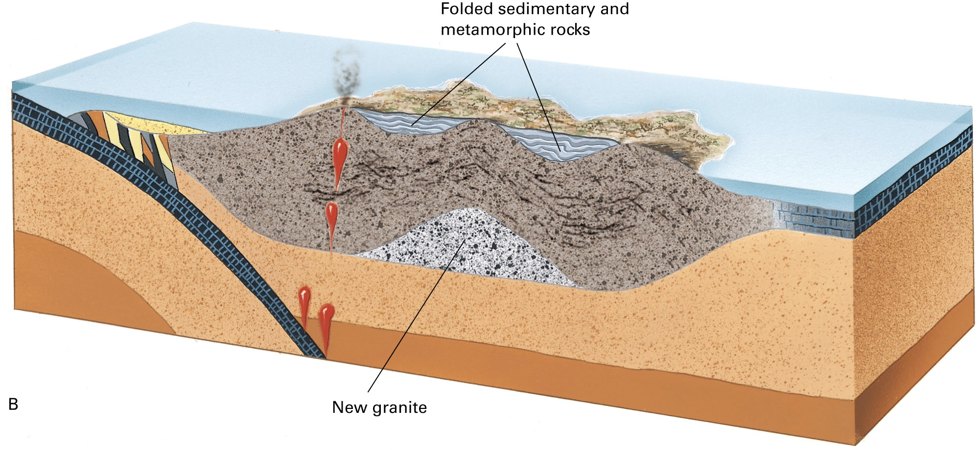
Vertical Mantle Plume Tectonics
Upwellings of hot mantle rock partially melted the upper mantle, creating basaltic magmas
Continued partial melting created intermediate to granitic magma
Notes:
Vertical Mantle Plume Tectonics
Upwellings of hot mantle rock, partially melted the upper mantle which led to basaltic magmas that eventually formed basaltic crust
Continued partial melting formed granitic continental crust
Evidence for both suggests that both methods were important
Plumes form thick basaltic oceanic plateaus, which then oozed outward to initiate horizontal motion, which led to subduction and another melting episode that generated continental crust

Slide 27
Magma Behavior
8.4
Notes:
Magma is less dense than the surrounding rock, so it rises and two changes occur:
1) Magma cools as it enters the shallower and cooler levels of the Earth
2) Pressure drops due to the weight of the overlying rock decreasing
Cooling tends to solidify magma, but decreasing pressure tends to keep it liquid
Whether it erupts or solidifies in the crust depends on composition
Basaltic magma tends to remain liquid and erupt on the surface
50%, 1 to 2% water
Granitic magma usually solidifies in the crust to form plutons
70% silica, up to 10% water

Slide 28
Effects of Silica on Magma Behavior
Silica tetrahedral link together to form chains, sheets and framework structures
In silica-rich magma, they will link to form long chains and short chains in silica poor magmas
Granitic magmas are viscous
Basaltic magmas are much less viscous and flow easily
Notes:
Effects of Silica on Magma Behavior
Silica tetrahedral link together to form chains, sheets and framework structures
In silica-rich magma, they will link to form long chains and short chains in silica poor magmas
Granitic magmas much more viscous, so it rises slowly and has more time to solidify, while
Basaltic magmas are much less viscous and flow easily, so the rise quickly

Slide 29
Effects of Water on Magma Behavior
Water lowers the temperature that magma solidifies
Under high pressure water stays dissolved in magma
As magma rises, pressure goes down and water escapes, so solidification temp rises, causing it to crystallize
Notes:
Effects of Water on Magma Behavior
Water lowers the temp at which magma solidifies
Dry granitic magma solidifies at 700 degrees C
Granitic magma with 10% water may solidify at 600 degrees C
Water escapes as steam from hot magma at the surface, under high pressure the water is prevented from escaping
The magma rises and pressure is lessened, so it’s solidification temp rises, which causes it to crystallize
Water loss causes rising granitic magma to solidify within the crust
With only 1 to 2% water in basaltic magmas, water loss is not as important

Slide 30
Plutons
8.5
Stone Mountain, GA
Notes:
Pluton is a large mass of igneous rock that has solidified within the crust
Many tens of kilometers in diameter

Slide 31
Pluton Formation
Blobs of granitic magma form at base of continental crust
Rising magma pushes aside country rock and coalesces into a larger bubble
Uplift and erosion

Slide 32
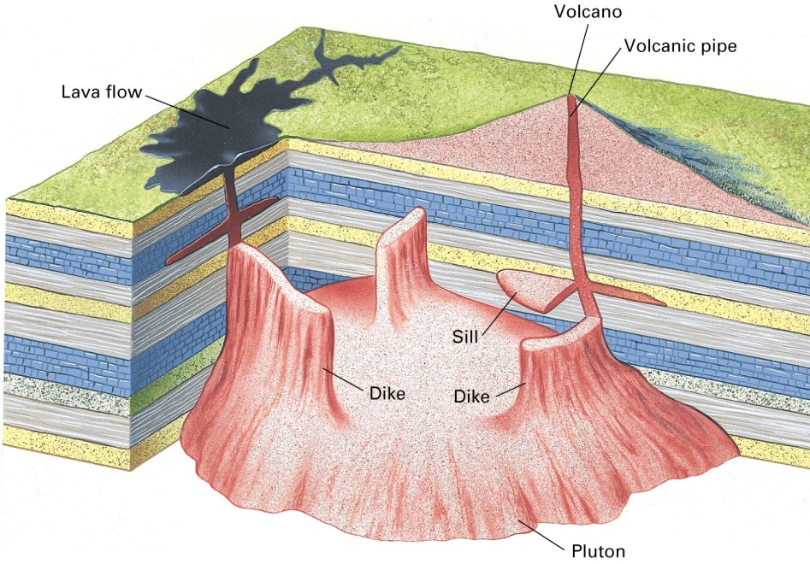
Terminology
Stock is part of a pluton where less than 100 square kilometers are exposed
Batholith is part of pluton where over 100 square kilometers are exposed at the surface
Smaller masses of magma can flow into fractures or between layers of country rock
Dike – tabular, sheet-like intrusive rock formed when magma oozes into a fracture
< cm to >km thick
Sill – oozes between layers of country rock, parallel to the bedding
< cm to >km in thickness

Slide 33
Exposed Plutons
Fig 8.9 – Large batholiths in western North America
Fig 8.10 – Granite plutons of the Sierra Nevada in Yosemite Nat’l Park
Notes:
Batholith is part of pluton where over 100 square kilometers are exposed at the surface
Average is 10 km thick (though some can be 20 km thick)
Commonly composed of several smaller plutons that have been intruded sequentially over millions of years

Slide 34
Dikes and Sills
Fig 8.13 – large dike near Shiprock, New Mexico, country rock weathered away
Fig 8.14 – basalt sill in Grand Canyon, injected between sandstone layers
Notes:
Dike – tabular, sheet-like intrusive rock formed when magma oozes into a fracture
< cm to >km thick
Can be more resistant to weathering than country rock
Sill – oozes between layers of country rock, parallel to the bedding
< cm to >km in thickness

Slide 35
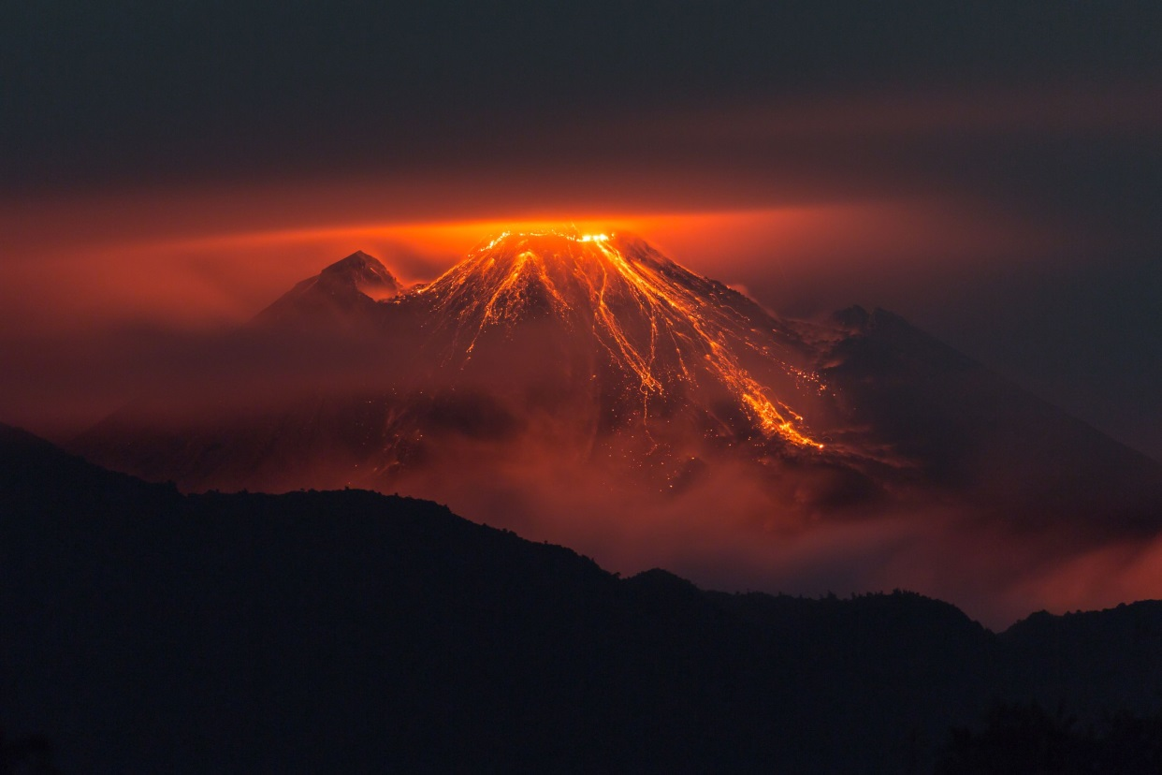
Volcanoes
8.6
Reventador – Eastern Andes, Ecuador
Notes:
Hill or mountain formed from lava and rock fragments ejected through a volcanic vent
Creates a wide variety of rocks and landforms, islands

Slide 36
Lava and Pyroclastic Rocks
Lava – magma that flows onto the surface and the rock it forms
onebigphoto.com

Slide 37
Lava Types
Pahoehoe Coil
Pahoehoe flow from Kilauea
USGS
USGS
Notes:
Pahoehoe
Hawaiian for “smooth” or “polished”
Low viscosity
Forms smooth, glassy, wrinkles, “ropy” ridges

Slide 38
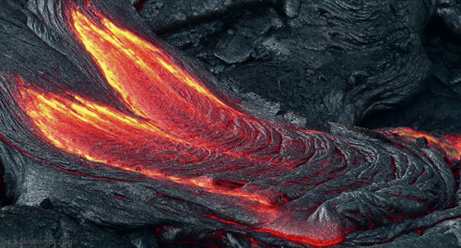

Slide 39
Lava Types
A’a lava flow
A’a lava flow
Notes:
AA
Hawaiian for “stony” or “rough”
High viscosity (due to gas or low temp), surface partially solidifies as it flows
Forms jagged, rubbled, broken surface

Slide 40
Vesicles
Fig 8.16 – A’a lava showing vesicles, Shoshone, Idaho
Vesicles in basalt, Owens Valley, California
Callan
Notes:
Vesicles
Bubbles of escaping gas (CO2, water) form when the lava is solidifying

Slide 41
Columnar Jointing
Giants Causeway, Ireland
Litlanesfoss, Iceland
Notes:
As lava cools and solidifies, it shrinks, forming cracks, the cracks grow downwards as the lava continues to solidify
Columnar joints
Regularly spaces five or six sided columns

Slide 42
Pyroclastic Rock
Volcanic ash
Pyroclastic Bomb
USGS
Steve Mattox
Notes:
Pyroclastic rock – solid rock fragments ejected explosively from a volcano
Volcanic ash – smallest particles, tiny fragments of glass
Cinders – volcanic fragments four to thirty-two millimeters in size
Lapilli
Bombs – larger than 64 mm

Slide 43
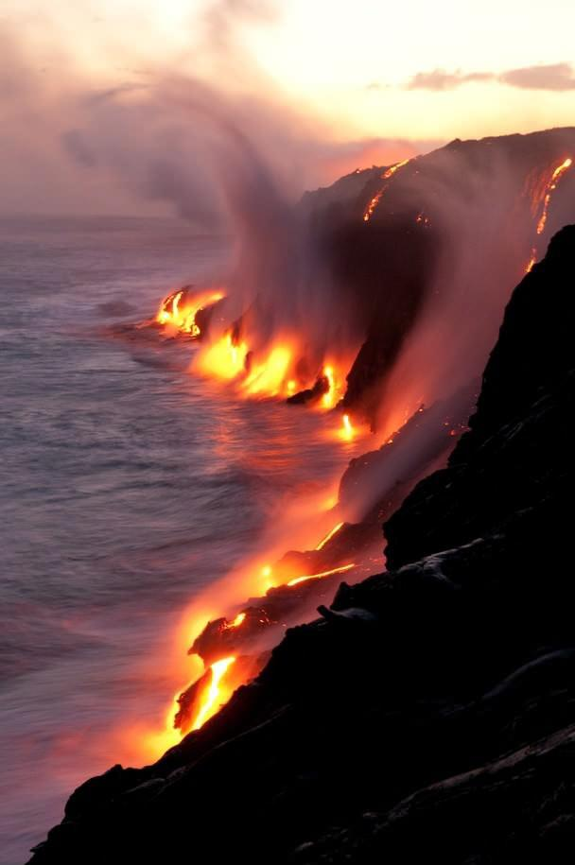
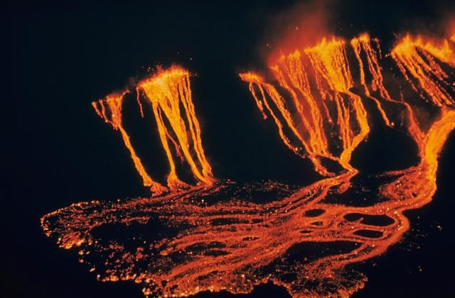
Fissure Eruptions and Lava Plateaus
Gentlest type of eruption
Viscous lava oozes from fissures and flows over land like water
Hawaii
Kilauea Iki lava fountains and flows, from USGS
Notes:
Fissure Eruptions and Lava Plateaus
Gentlest type of eruption, the lava is so viscous that it oozes from fissures (cracks in the land surface) and flows over the land like water
Vary in size
Small cracks on the sides of a volcano
Hawaiian and Icelandic volcanoes

Slide 44
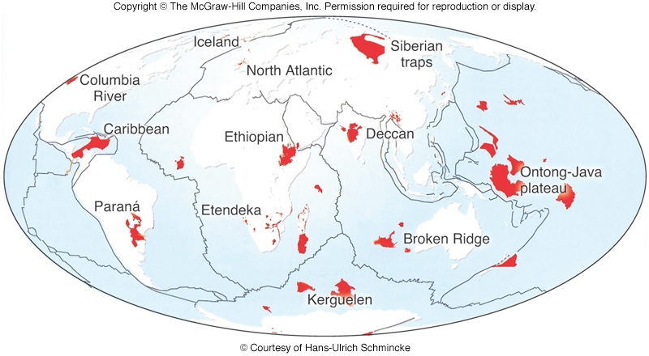
Lava Plateus
Thousands of cubic kilometers of basaltic lava forming a flood basalt

Slide 45
Columbia River Plateau
Notes:
Columbia River plateau
350,000 cubic km of basalt
3000 m thick
Covering 200,000 square km
15 million years old

Slide 46
Volcano Types
Volcanic vent on flank of Pu`u `O`o on the east rift zone of Kilaeua
Volcanic crater of Santa Ana volcano, El Salvador
USGS
USAF
Notes:
Vent – lava and rock fragments erupt from an opening in the crater
Crater – bowl-like depression at summit

Slide 47
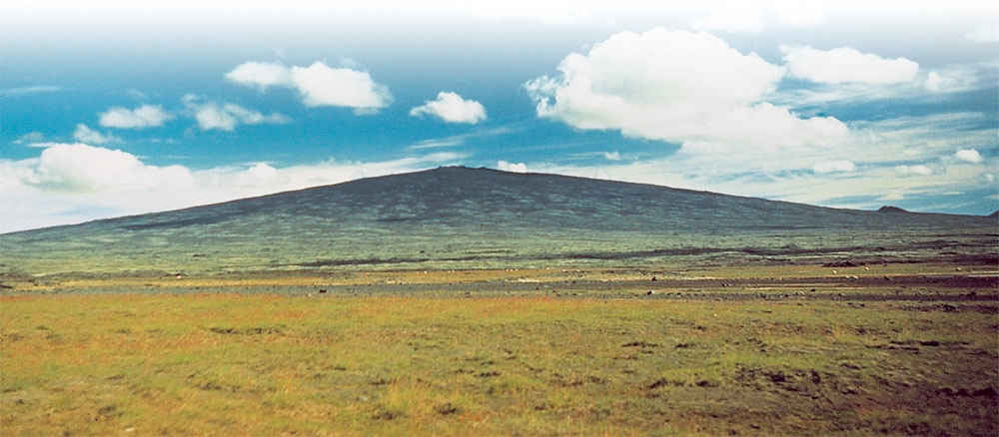
Shield Volcanoes
Fluid basaltic magma – forms gently sloping shape
Can be enormous
Gentle eruptions
Fig 8.20 – Mount Skjoldbreidier in Iceland
Notes:
Shield Volcanoes
Fluid basaltic magma builds a gently sloping mountain
Sides generally slope away from vent at angles between 6 and 12 degrees
Can be enormous
Mauna Kea in Hawaii, if measure from the sea floor, exceeds the height of Mount Everest
Normally have gentle eruptions, where flows advance slowly enough to give people time to evacuate

Slide 48
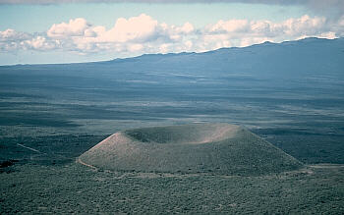
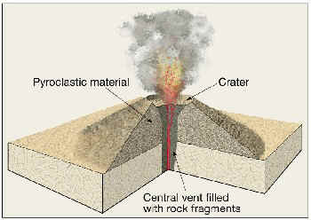
Cinder Cone
Composed of pyroclastic fragments
Large amounts of accumulated gas in magma
USGS
Notes:
Cinder Cones
Composed of pyroclastic fragments
Forms when large amounts of gas accumulate in the rising magma
Gas pressure builds until it reaches a point where is erupts explosively, hurling cinders, ash and molten magma into the air which them fall back around the vent to accumulate into the cone
Usually only active for a short time, until all the gas escapes (the driving force of the eruptions)
Symmetrical
Can be steep (about 30 degrees), especially around vent
Most less than 300m high, can reach up to 700m
Erodes quickly, as the pyroclastic fragments aren’t cemented together

Slide 49
Composite Cone (Stratovolcano)
Sequence of repeated lava flows and pyroclastic eruptions
Steep sided profile
Forms along subduction zones
Fig 8.22 – (A) composite cone
(B) Mount Hood, in Oregon
Notes:
Composite Cone (Stratovolcano)
Forms from a sequence of lava flows and pyroclastic eruptions
Lava covers the loose pyroclastic material, protecting it from erosion
Repeated eruptions over a long period of time
Forms some of the tallest mountains in volcanic regions
Mount St. Helens and Mount Rainier
Vesuvius and Pompeii

Slide 50
Composite Cone (Stratovolcano)
Mount St. Helens, 2002
Mt Vesuvius eruption, 1944
Cotsonika
Italian Air Force

Slide 51
Vesuvius and Pompeii
Vesuvius seen from the ruins of Pompeii
Garden of the Fugitives, Pompeii,
plaster casts of voids in the tephra layers

Slide 52
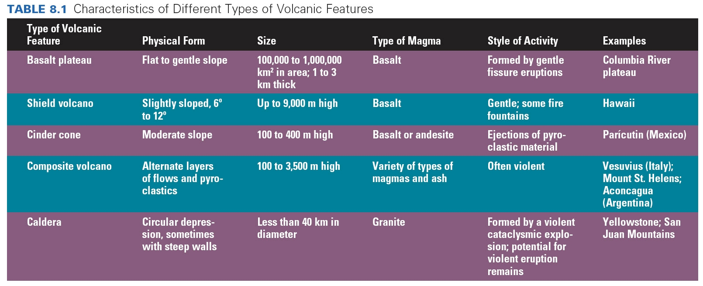
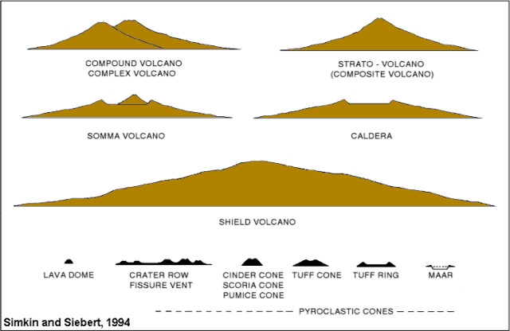

Slide 53
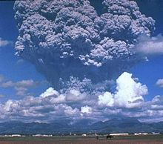
Volcanic Explosions: Ash-Flow Tuffs and Caldera
8.7
Mt Pinatubo, Philippines, 1991
Notes:
8.7 Volcanic Explosions: Ash-Flow Tuffs and Calderas
Granitic magmas that rise to the surface, tend to erupt violently
Usually dry, with only a few percent water
Decreasing pressure allows the small amount of dissolved water to form a frothy, pressurized mixture of gas and liquid magma that can be as hot as 900 degrees C
Rises to few km of the surface it fractures overlying rocks and explodes skyward

Slide 54
Ash Columns
Ash column of the Shiveluch stratovolcano in Russia
Mount St. Helens on July 22nd, 1980
NASA
Notes:
Large and violent eruption can blast a column of pyroclastic material 10 to 12 km into the sky, with fine ash rising even higher (possibly into the upper atmosphere)
Force and amount of material can hold the column up for hours or even days

Slide 55
Ash Flows
Mount Augustine, Cook Inlet, Alaska
Rhyolitic ash-flow tuff, Traveler Mountain, Maine
Jim Rosen / Accent Alaska
Photo from Rankin and Caldwell, 2010
Notes:
Ash Flows
When most gas has escaped from the upper layers of magma, the eruption ends and the airborne column of pyroclastics (ash, rock, gases) falls back to Earth’s surface, spreading over the land forming an ash flow
When the flow stops, the gas escapes into the atmosphere, leaving behind a mixture of ash and rock fragments called an ash-flow tuff

Slide 56
Calderas
Crater Lake, Oregon
Diamond Head, Hawaii
Notes:
Calderas
After the eruption, roof of the magma chamber collapses into the space that the magma had filled, forming a circular depression called a caldera
Large ones can be 40 km in diameter with walls a km high
Can fill up from volcanic debris as the ash column collapses
Some maintain shape
Crater Lake
Diamond Head

Slide 57
Calderas
Aogashima Island, Japan
Santorini, Greece
(classically known as Thera)
Notes:
Aogashima
Four overlapping calderas
Last eruption 1781-1785
Santorini, Greece (classically known as Thera)
Remnant of a caldera
Last known eruption 1950
What remains after an enormous volcanic eruption that destroyed settlements on what used to be a single island
Minoan Eruption – 3600 years ago
Popular theory is that Thera eruption led to the legend of Atlantis
May have been one of the largest eruption of Earth in the last few thousand years

Slide 58
Risk Assessment: Predicting Volcanic Eruptions
8.8

Slide 59
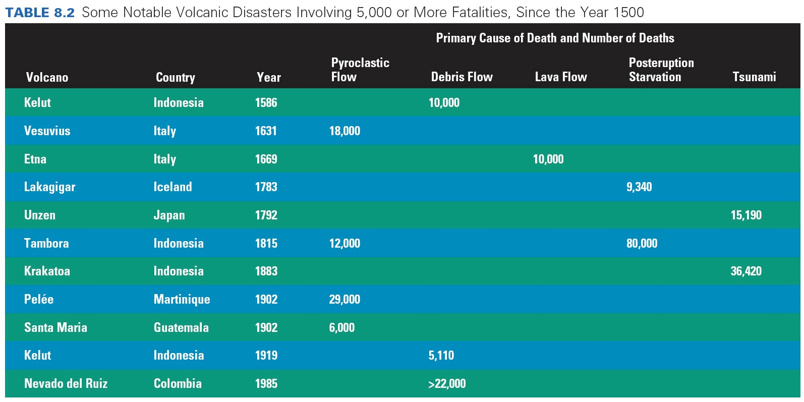
Notes:
8.8 Risk Assessment: Predicting Volcanic Eruptions
Table 8.2
Major known volcanic disasters since 1500s
One of the greatest geologic hazards
1300 active volcanoes recognized globally
5564 eruptions have occurred in the past 10,000 years (no MORs)

Slide 60
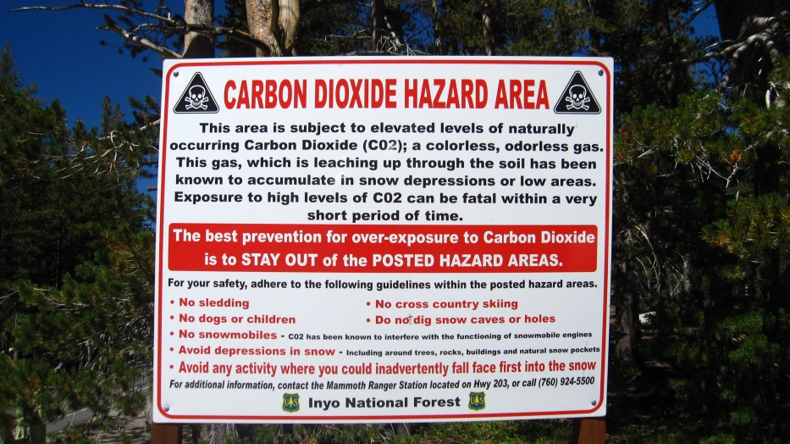
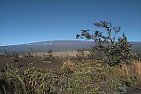
Volcanic Hazards
Pyroclastics from Etna
Lahars in Japan
Mauna Loa
Vog obscured view

Slide 61
Unzen Dome Collapse, 1991
Pyroclastic flow

Slide 62
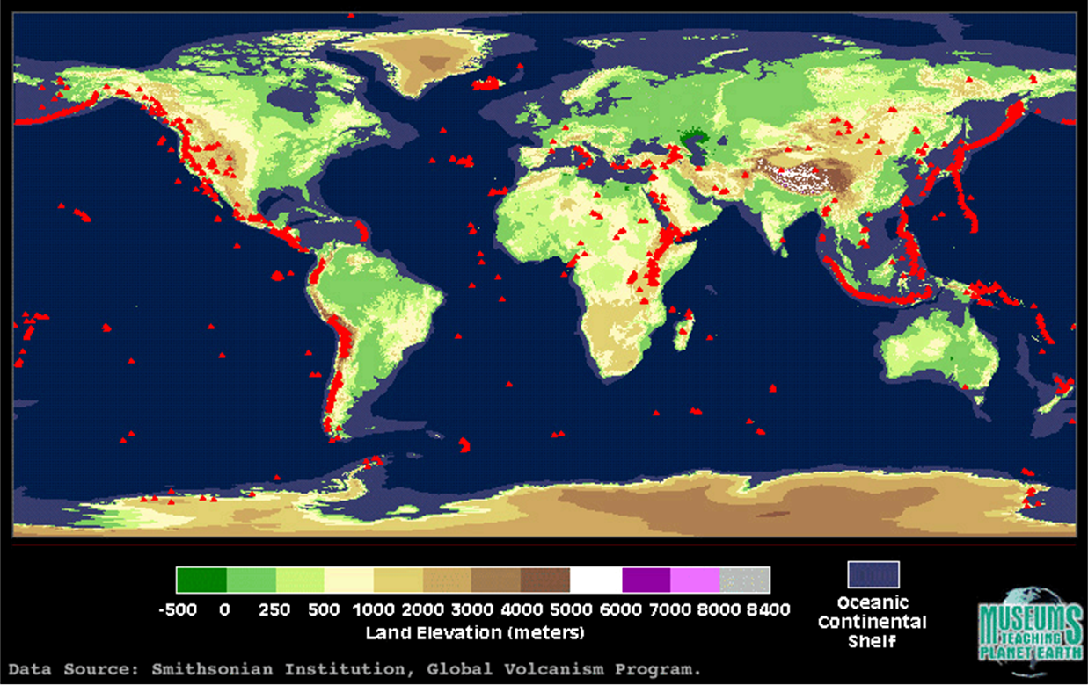
Regional Prediction
Based on frequency of past eruptions and potential violence
Only estimate possibilities and can’t determine exactly when one will erupt or the intensity
Notes:
Regional Prediction
Based on frequency of past eruptions and potential violence
Only estimate possibilities and can’t determine exactly when one will erupt or the intensity

Slide 63
Short-Term Prediction
Attempt to forecast specific time and place
Based on instruments that monitor active volcanoes
Changes in shape
Earthquakes
Gas/Ash
Increased hot spring temps
Japanese Space Agency
Ground velocity map of the west Sunda volcanic region.
Notes:
Short-Term Prediction
Attempt to forecast the specific time and place
Based on instruments that monitor active volcanoes
Signals
Changes in the shape of the mountain and surrounding land
Earthquakes swarms that indicate that magma is moving below the surface
Increased emissions of ash or gas
Increasing temps of nearly hot springs

Slide 64
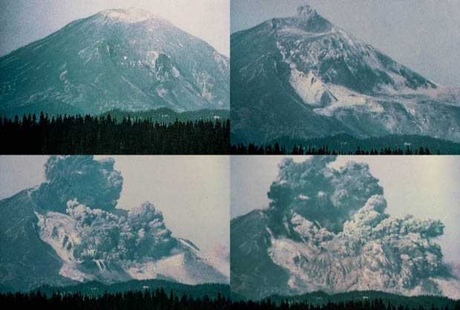
Mount St. Helens
Gary Rosenquist
Notes:
1978 - two USGS geologists noted that Mount St Helens had erupted more frequently and violently that any other volcano in the lower 48 and predicted it would erupt again before the end of the 20th century
March 1980 – two months before the big eruption, puffs of steam and volcanic ash rose from the crater and swarms of earthquakes occurred beneath the mountain
Were able to evacuate the area surrounding the mountain before the large eruption occurred
May 18, entire north face of mountain blew out
Magnitude 5.0 quake, with a resulting landslide that was ½ mile wide and a mile from top to bottom.
Volcanic gas a steam shot out of opening in the north side and blew trees down 17 miles away
Ash cloud spread for hundreds of miles
57 people died

Slide 65
Mount St. Helens
Mount St. Helens, 1980
Mount St. Helens, 2002

Slide 66
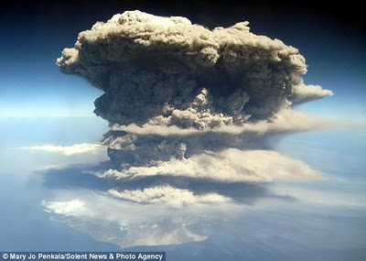
Volcanic Eruptions and Global Climate
8.9
Eruption of the Soufriere Hills volcano, on the island of Montserrat.
Notes:
Eruptions can profoundly affect the atmosphere, climate and living organisms

Slide 67
Cooling Effects
Mount Pinatubo, USGS
Notes:
1991 eruption of Mount Pinatubo in the Phillippines
Produced greatest clouds of ash and sulfur seen in the latter half of the 20th century
Total solar radiation declined by 2 to 4% following the eruption
1992 and 1993 – few tenths of a degree Celsius cooler then the temps of the previous decade
1994 temps rose again after the ash and sulfur settled out
Correlation between global cooling and volcanic eruptions
Substantiates models showing high-altitude dust reflects sunlight and cools the atmosphere

Slide 68
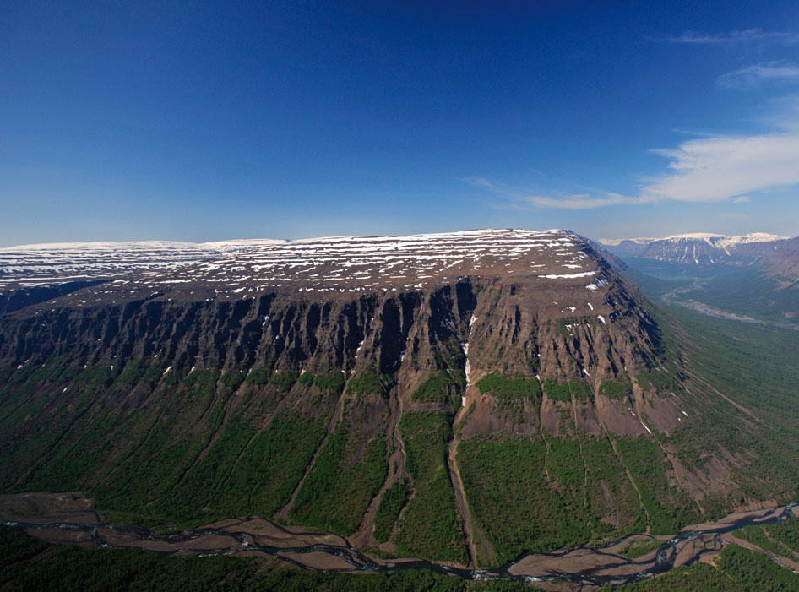
Permian Extinction
248 million years ago (mya) 90% of all species died
Coincides with eruption of Serbian flood basalts
Volcanic ash
Sulfate aerosols
Nature.com
Notes:
Permian extinction and Siberian flood basalt
Released massive amounts of ash and sulfur compounds into the upper atmosphere to cool enough to cause/contribute to the mass extinction

