Slide 1
Oso, Washington
3/22/14

Slide 2
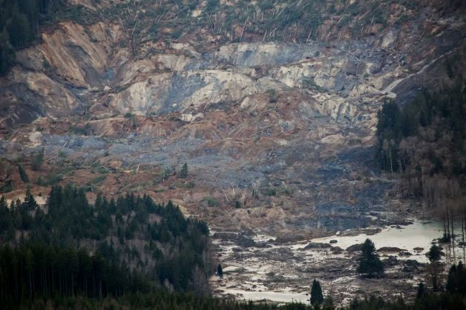
Photo: Marcus Yam/The Seattle Times/via AP

Slide 3
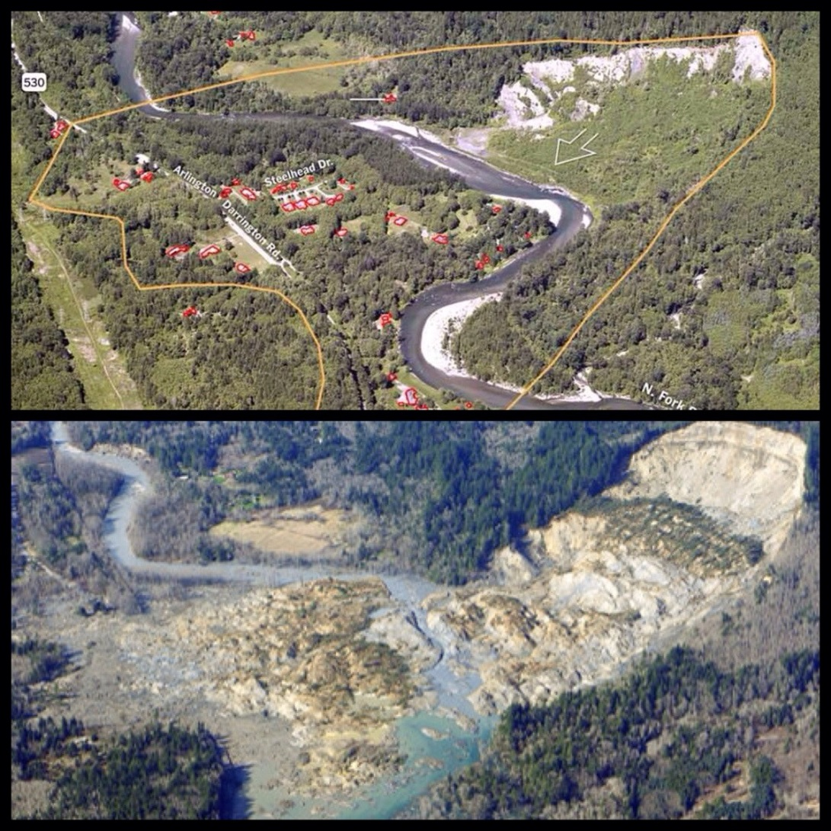
Notes:
Washington state mudslide happened Saturday, March 22nd, 2014
Destroyed a small community 55 miles northeast of Seattle
Estimate of 10 million m3, spread across one square mile
flattened two dozen homes
critically injured several people
at least 24 dead, working off a list of 176 missing people (may be duplicates on list)
Rescue crews working in quicksand-like mud, 15 feet deep in some places, potential for flash flood and more slope failures to occur
Ed Hrivnak, co-pilot of one of first responding aircraft, said houses weren’t buried, “they exploded”, cars were crushed to pieces
Landslide happened in same area in 2006

Slide 4
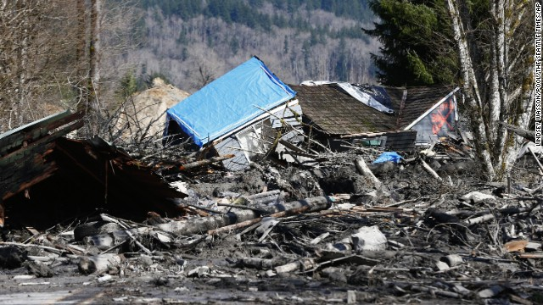

Slide 5
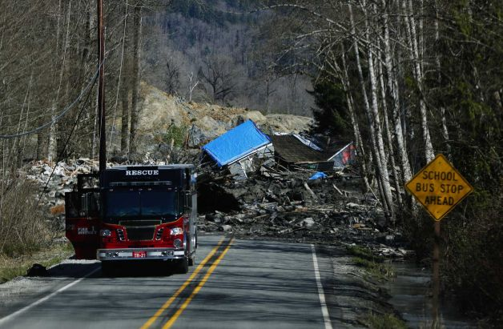
Photo: Lindsey Wasson, AP

Slide 6
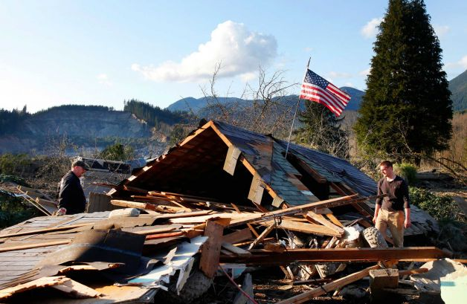
Photo: GENNA MARTIN, THE EVERETT HERALD

Slide 7
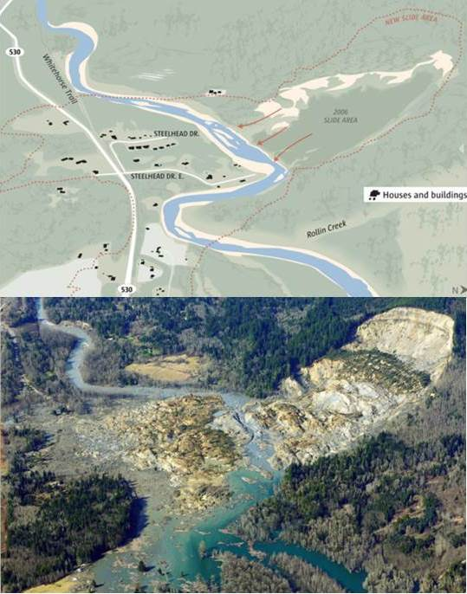
Notes:
Homes below were built in 2007, within weeks of previous slide
Report by geomorphologist, Daniel Miller, filed in 1999 told of “potential for a large catastrophic failure”
Reports going back to 1950s contained warnings
Referred to as “Slide Hill” in a 1967 Seattle Times story
River is constantly eroding the “toe” of the previous slide which supports the hillside behind it, undercutting and destabilizing the hill again until it fails
Almost impossible to stabilize the hill at this point

Slide 8
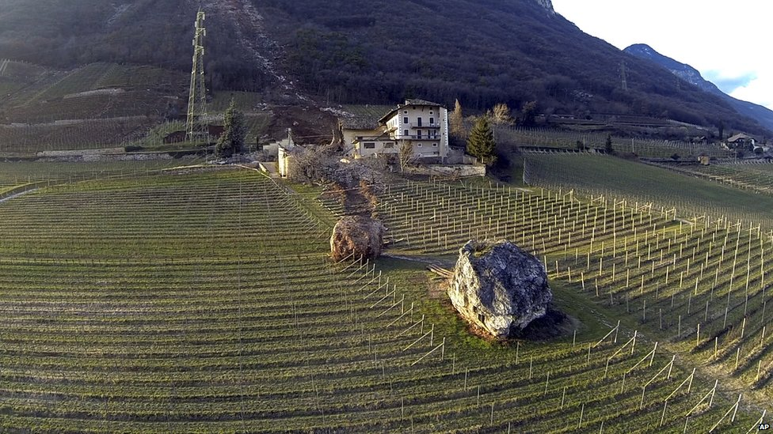
Jan 23rd, 2014
Ronchi di Termeno, Italy
Markus Hell/Tareom.com/AP

Slide 9
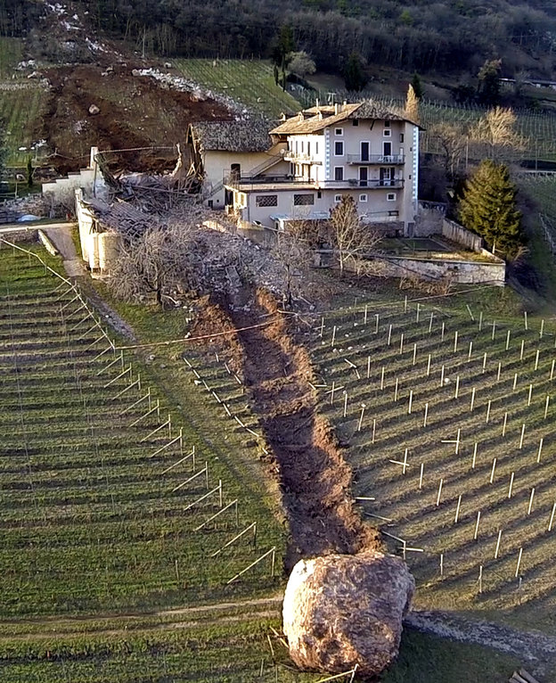
Markus Hell/Tareom.com/AP

Slide 10
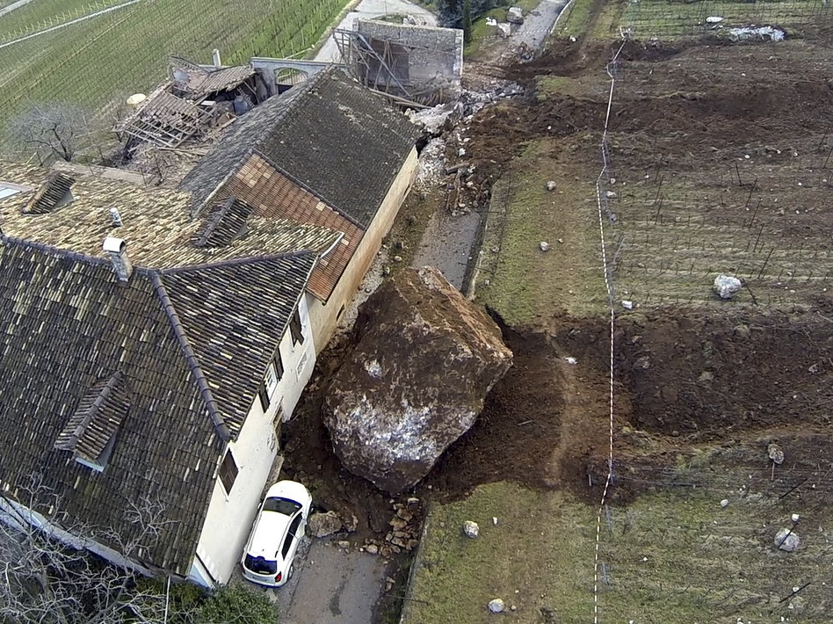
Markus Hell/Tareom.com/AP

